Slide 1
3-D Printing
MARRS Workshop
Jackson State University
Dr. Walter Deal, wdeal@odu.edu
Dr. Feng Jao, f-fao@uni.edu
Dr. Steve Hsiung, shsiung@odu.edu

Slide 2

An overview of 3-D printing
Objectives
Describe or explain what 3-D modeling is.
Briefly highlight the 3-D printing process.
Explain the concept of an “additive” manufacturing process.
Describe why 3-D printing is an important industrial process.
State 3 examples of 3-D printed products.

Slide 3
What is 3-D Printing?
Processes used to create a three-dimensional object in which layers of material are formed under computer control to create an object.
Additive process – building by adding material
Produced from 3-D model or data
Back

Slide 4
3-D printing – Additive manufacturing process
It is an additive manufacturing that emphasizes the transformation of a 3-dimensional (3-D) design model, typically specified as a 3-D CAD (Computer Aided Design) model file, is directly and automatically fabricated via a machine, such as a 3-D Printer, without the need for any intermediate manufacturing processes.
Back

Slide 5
Making things happen…
…How designing on a computer and putting ideas into virtual files also changes the way we create products. Newer and better products can be designed in a world where people work together to make great things happen.¹
Back

Slide 6
Why is 3-D printing important?
3-D printing is one of the key future technologies today.
The technology enables businesses to cut costs, reduce time to market, produce stronger and lighter parts, improve efficiency, and solve design and production and other challenges.
It is important for students to have an understanding of the technology in the 21st century global economy.
Simply… Today’s Students - Tomorrow’s Workforce
Back

Slide 7
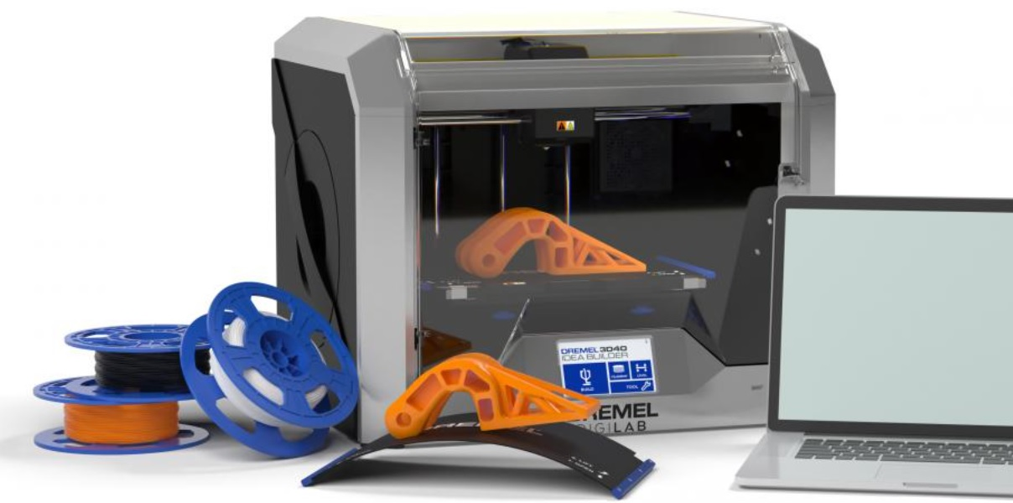
Dremel Desk Top 3-D Printer
Printer
Printed Part
Filament
Computer

Slide 8
3-D printing –materials and products
Basically, anything can be 3-D printed from plastics to metals – gold, silver and even titanium or food
Items such as jewelry, dental implants, prosthetic devices, automotive parts, repair parts, human organs (bio-printing), industrial prototypes , shoes and clothing, toys and a host of other products
Back

Slide 9
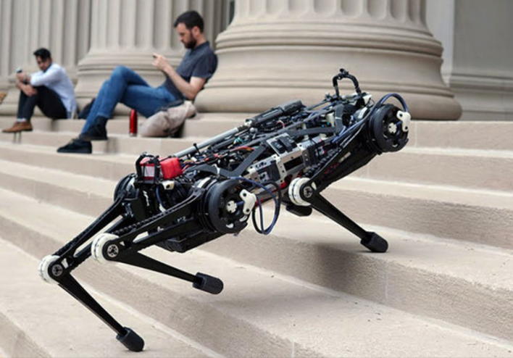
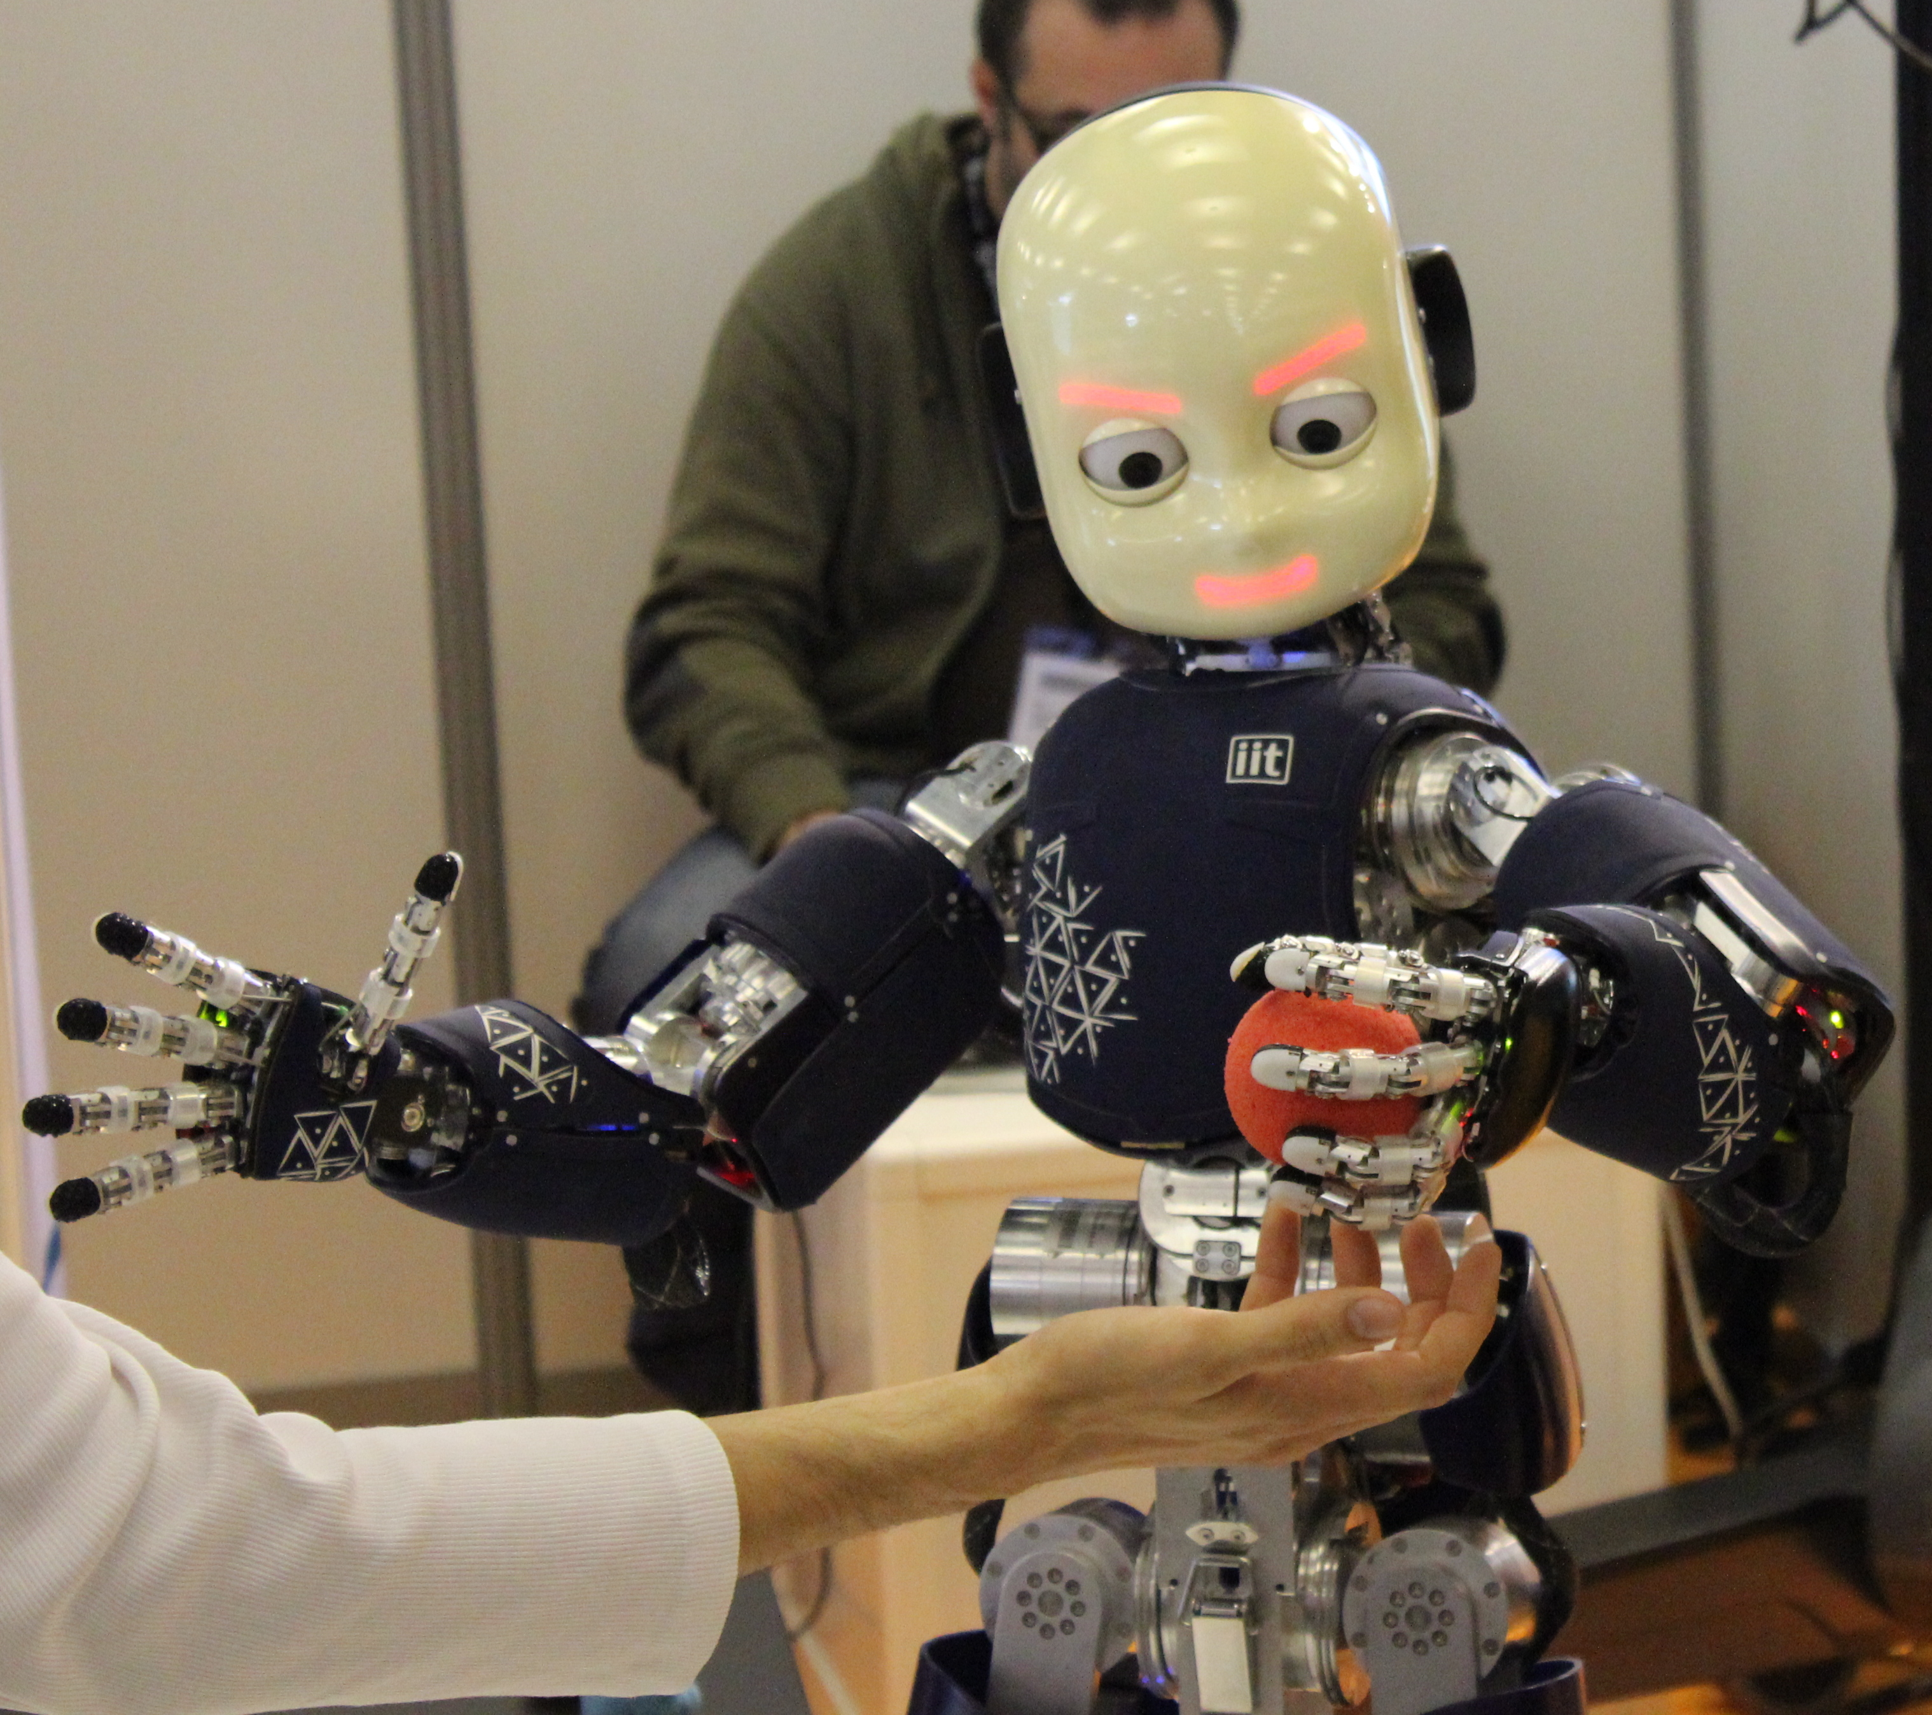
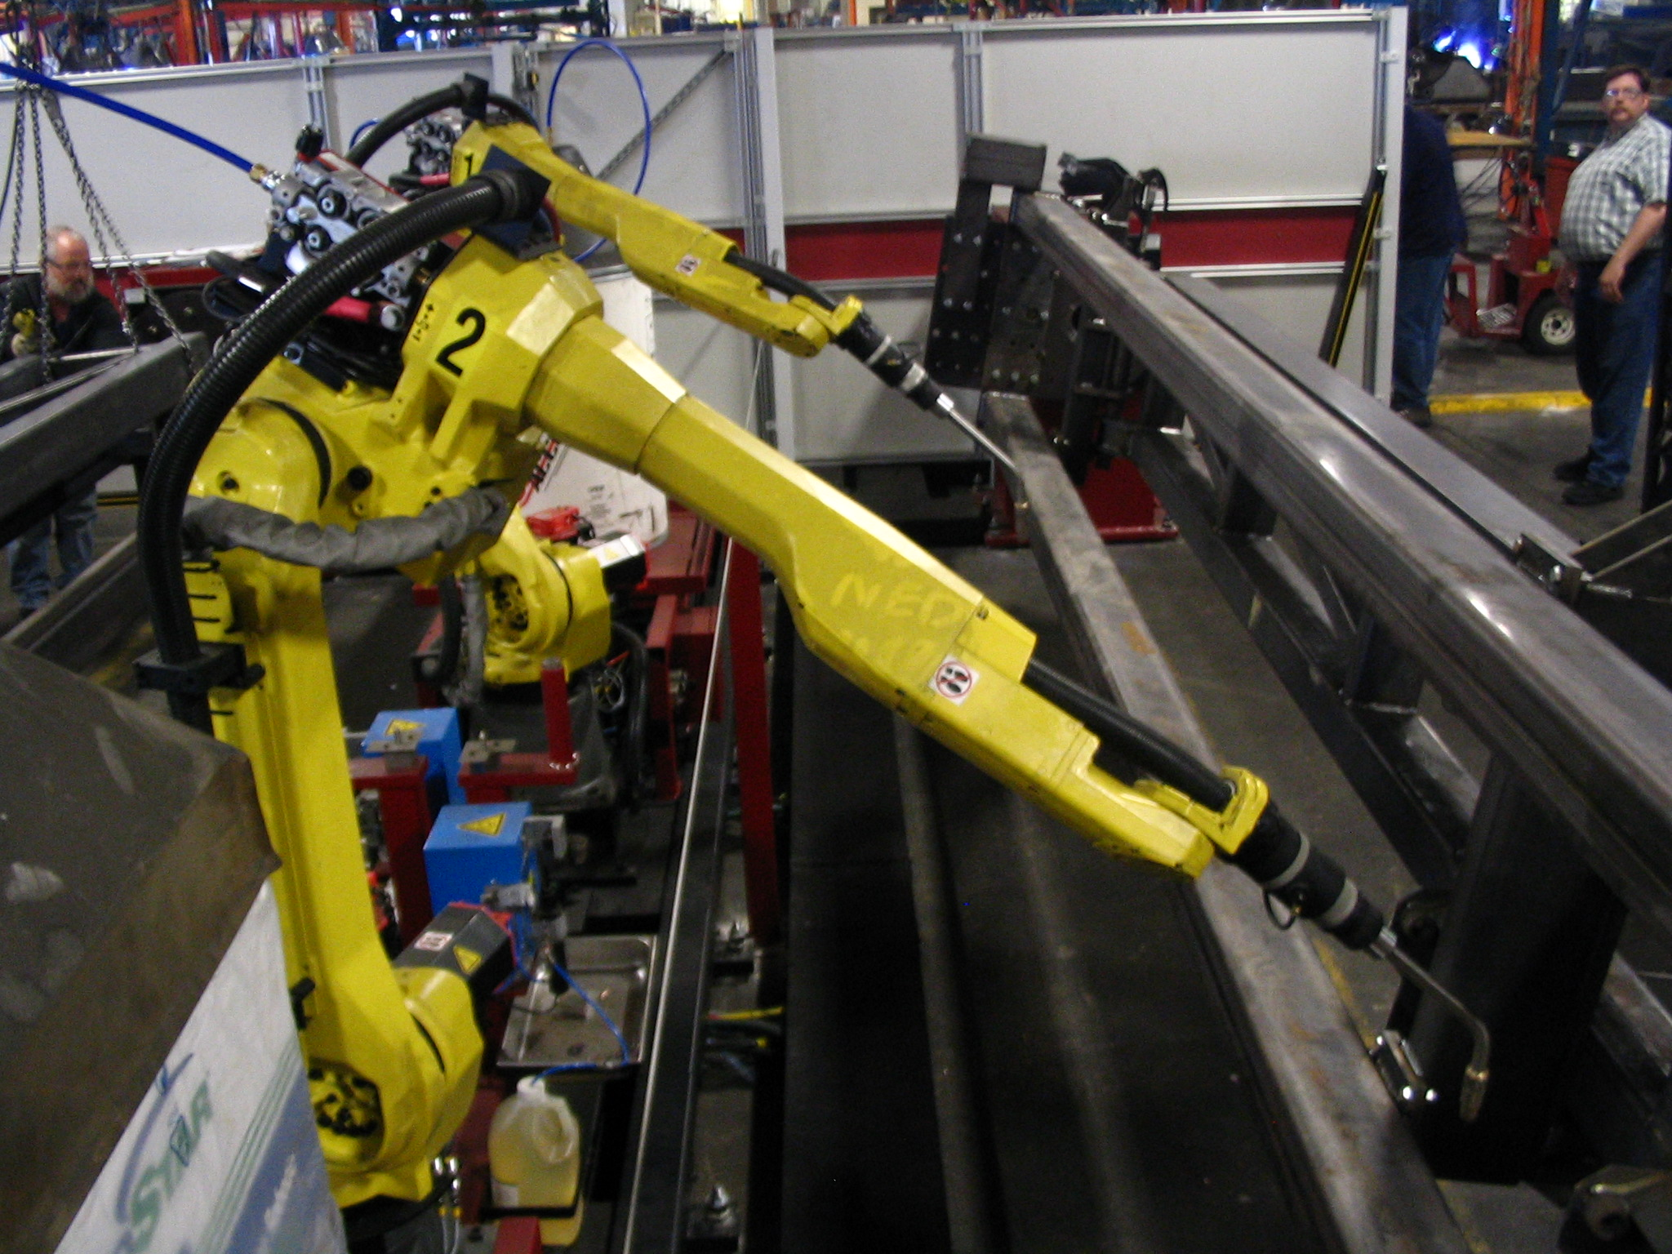
Industrial practice in 3-D printing
Robotics
  A robot is a machine - especially one programmable by a computer - capable of carrying out a complex series of actions automatically.

Slide 10
3-D Design and Printing in this workshop
  Software – Autodesk Inventor
  Professional 3-D mechanical design tool
  Allow product development lifecycle, Cloud management, and enable assembly reconfigurations!
  Easy to start and powerful for professional 3-D design!

Slide 11
Unlock educational access to Autodesk products
Students and educators can get free one-year educational access to Autodesk products and services
Renewable as long as you remain eligible as an educator or student
Autodesk Education

Slide 12
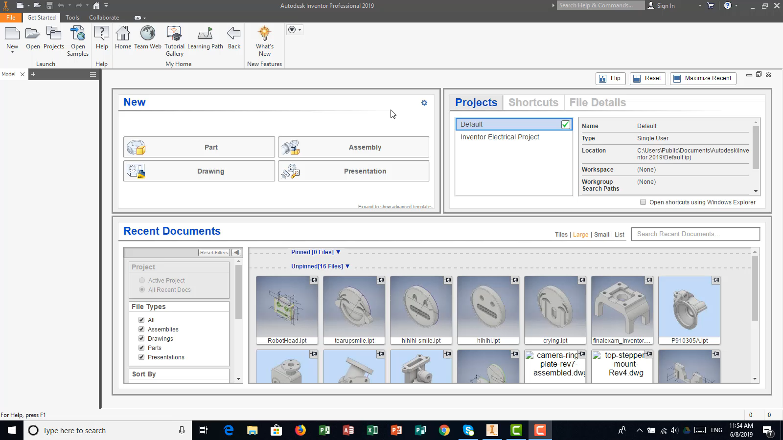
Autodesk Inventor – Create a 3-D model
Back
See Video: https://youtu.be/DEhj0lmFSt8

Slide 13

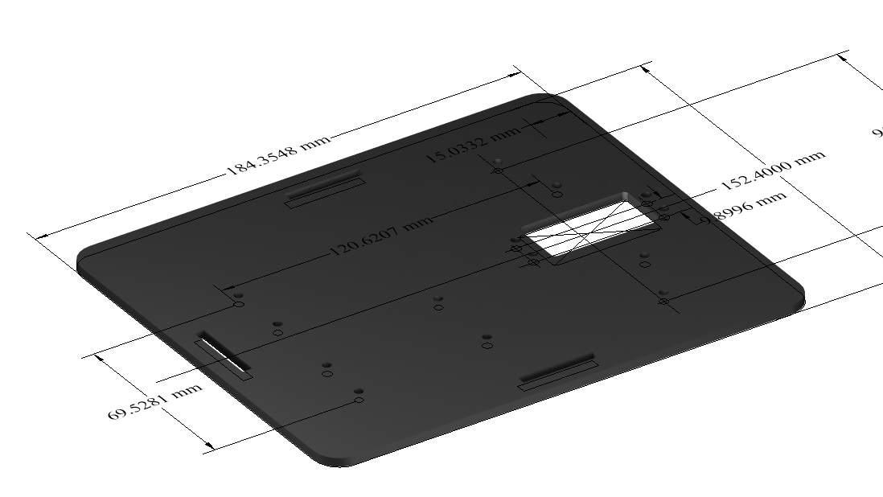
3-D Modeling file – Rover Platform

Slide 14
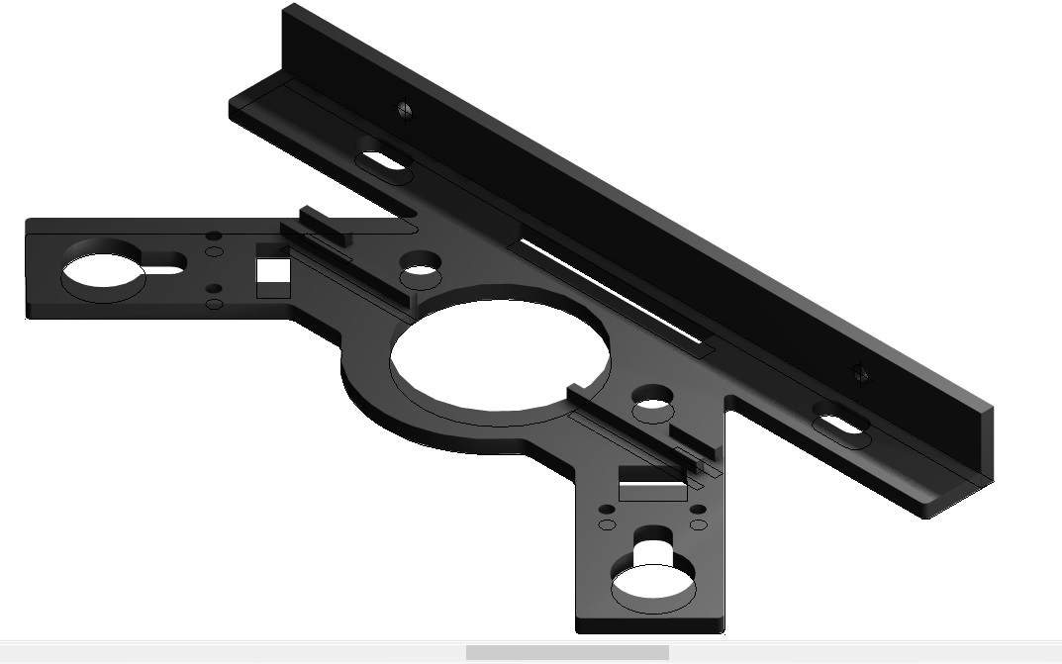
Rover Motor Plate – 3-D STL file
STL is a file type used with 3-D modeling - Stereolithographic
Back

Slide 15
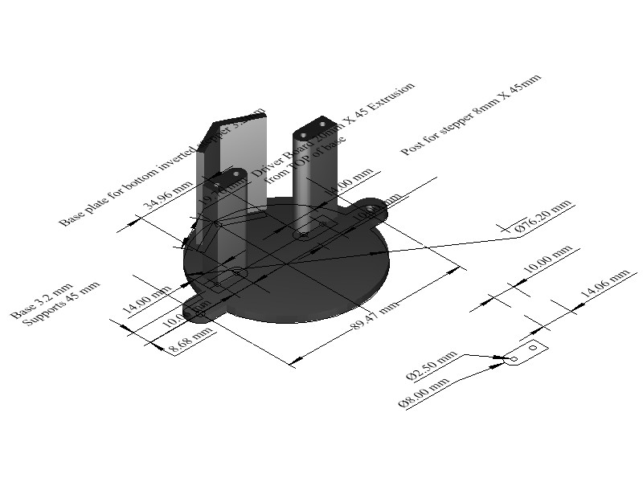
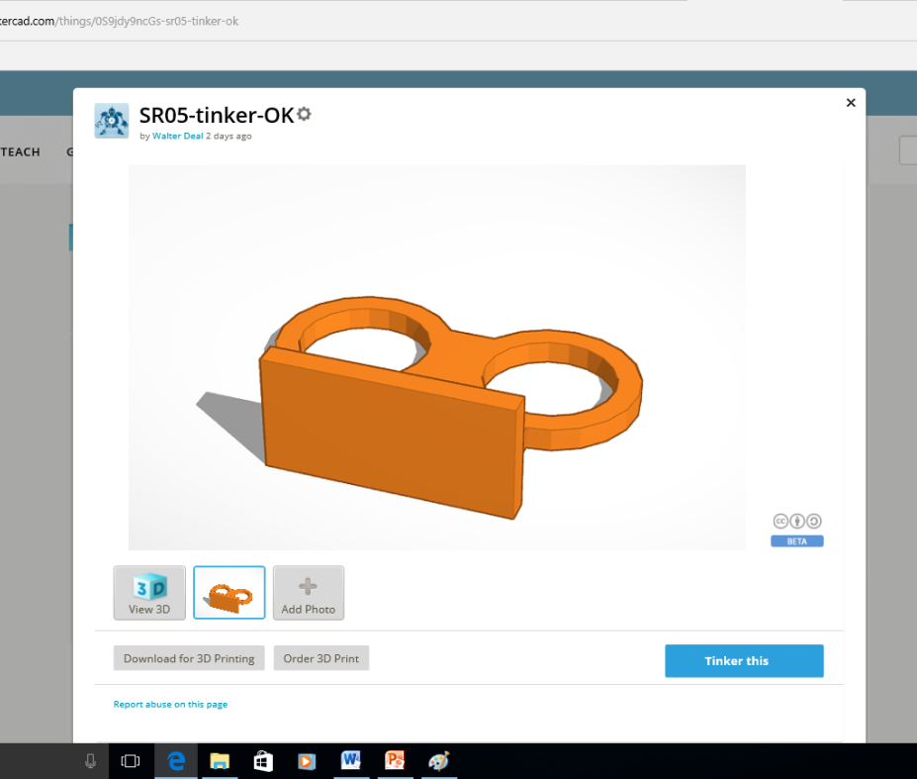
Create stl file for 3-D printing
Export 3-D modeling files (.dwg or .ipt) to stl

Slide 16
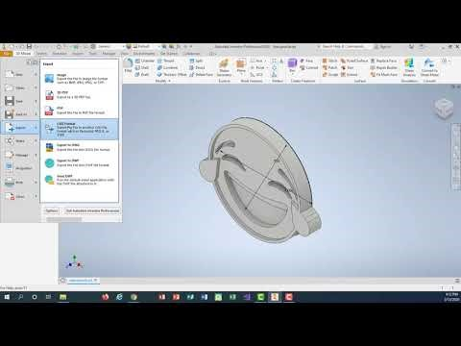
Convert Files to Stl for 3-D printing - video

Slide 17
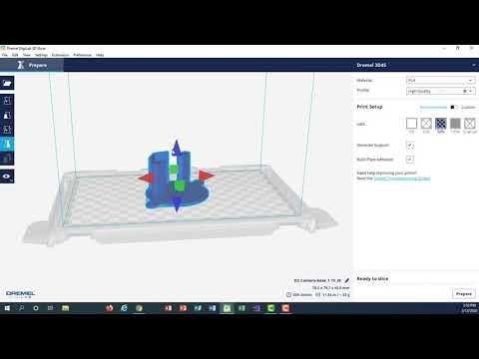
Dremel (3D printer) - Converts stl file to gcode
Back

Slide 18
Summary
Describing what is 3-D printing (Link)
3-D Printing – additive manufacturing process (Link)
Designing on a computer changes the way we create (Link)
Importance of 3-D printing (Link)
Materials and products (Link)
Creating a 3-D model (Link)
3-Dimensional files – STereoLithographic or STL (Link)
Creating a 3-D design and exporting (Link)
Preparing to print a 3-D product (Link)

Slide 19
Resources
10 Examples of How 3-D Printing Is Changing Consumer Products
Autodesk Inventor - Education License – 3-D design and modeling software
TinkerCAD 3-D app – Free easy-to-use online app for 3-D design for teachers, kids and hobbyists

