Slide 1

STEM Explorations with 3-D Printed Rover
Jackson State University January 2021

Slide 2
Good morning…
Great to see you here!

Slide 3
Special Thanks & Welcome
Dr. Mehri Fadavi, Chair & Professor of Physics
Project Director - Jackson State University
Dr. Teresa Demeritte, Project Coordinator
Mathematics Advancement through Professional Development (MAT-PD) Mr. Cary Smith, Math Science Partnership Coordinator
Jackson State University

Slide 4
Who we are…
Dr. Steve Hsiung
Professor of Electrical Engineering Technology
Old Dominion University – Norfolk, VA
Dr. Walt Deal
Emeriti Associate Professor of Industrial Technology
Old Dominion University – Norfolk, VA
Dr. Feng Jao
Professor of Technological Studies
Ohio Northern University, Ada, OH

Slide 5
What we are going to do…
Explore 3D design and printing
Identify STEM career areas and pathways
See AutoDesk Inventor Design & 3-D Modeling Process
See 3-D printing process
Assemble a 3-D printed Robot Rover
Program an Arduino Microcontroller
See easy-to-do Arduino Science/STEM Activities
Test a programmed Robot Rover with Video Camera
Participate in a Virtual Rover competitive event
Explore STEM related careers and other opportunities
Everything is available on:
www.ucdistancetraining.org

Slide 6
Our Schedule Today
8:30 – 9:00 Workshop Overview
9:00 – 9:45 3-D Printing Overview
9:45 – 10:00 Break
10:00 – 11:45 Mechatronics & STEM Connections
11:45 – 1:00 Lunch Break
1:00 – 2:00 Rover Assembly
2:00 – 2:45 Programming Arduino Rover
2:45 – 3:00 Break
3:00 – 4:00 Bluetooth
4:00 – 4:30 Rover Operation
See Workshop Schedule On-Line

Slide 7
Career things…
The future is bright…

Slide 8
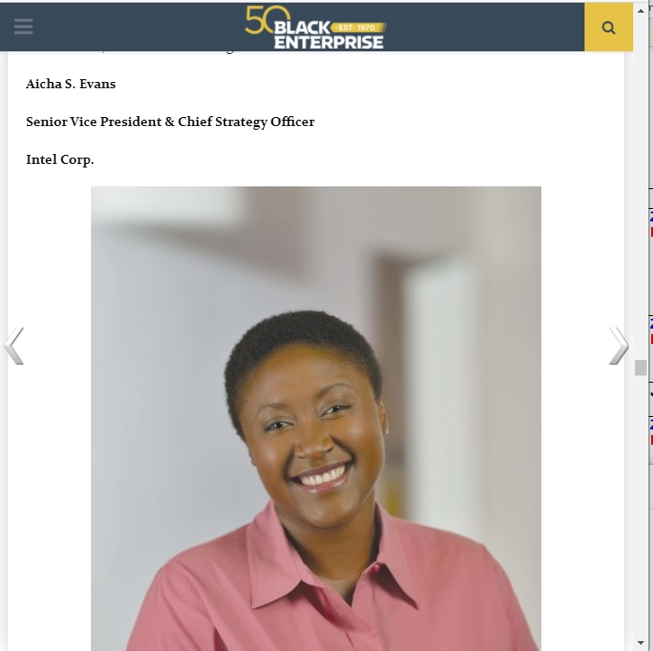
Alicha S. Evans – CSO Intel
“As Senior Vice President and Chief Strategy Officer at Intel Corp., Aicha S. Evans leads Intel’s efforts to convert from a PC-centric company to a data-centric juggernaut. Selected one of be’s Most Powerful Executives in Corporate America…”
Retrieved: List of the Most Influential Blacks in Technology (blackenterprise.com), January 26, 2021

Slide 9
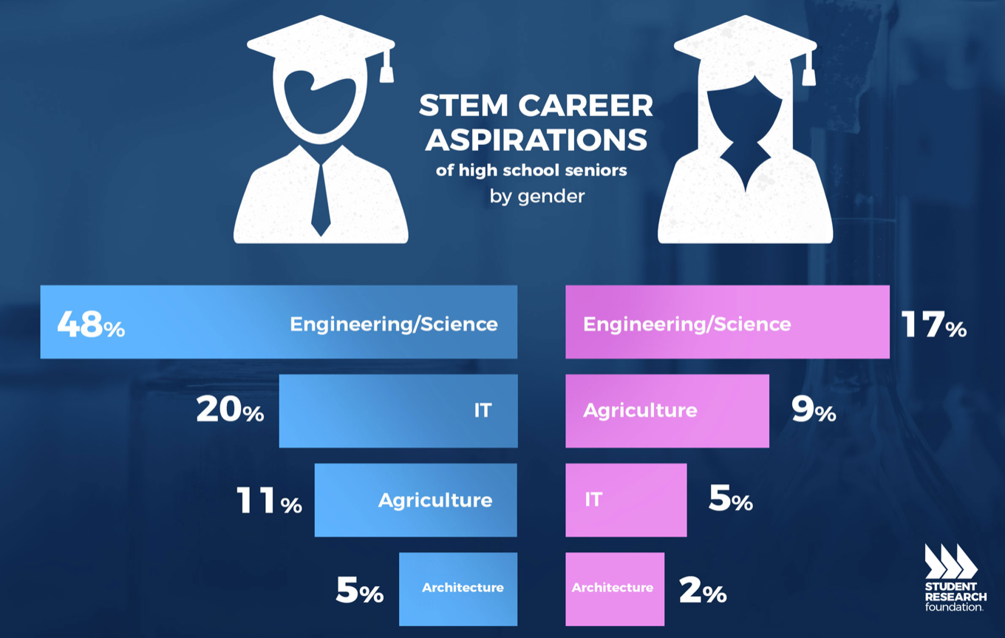
Increasing pathways to Science, Technology, Engineering, & Math Related Careers

Slide 10
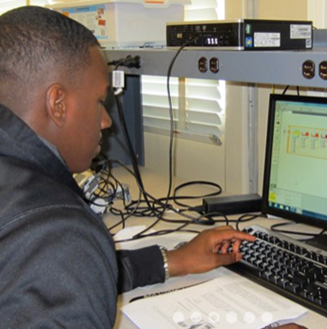
Career choices start early…
Communication skills
Computer skills
Information management
Researching – reporting – documenting
Career planning and preparation
Advancement

Slide 11
Career awareness…
COVID-19 virus places new challenges for teachers & students in a remote setting…
Hands-on STEM activities are engaging – touching, feeling, building, problem solving and testing
Middle School Opportunities – Build interest and enthusiasm in STEM areas and activities
Simple fun activities that highlight ideas, concepts & exploration
ZOOM Team Pals – working together on common projects
High School Opportunities – Robotics, coding and programming, 3-D printing, designing and construction – career directions

Slide 12
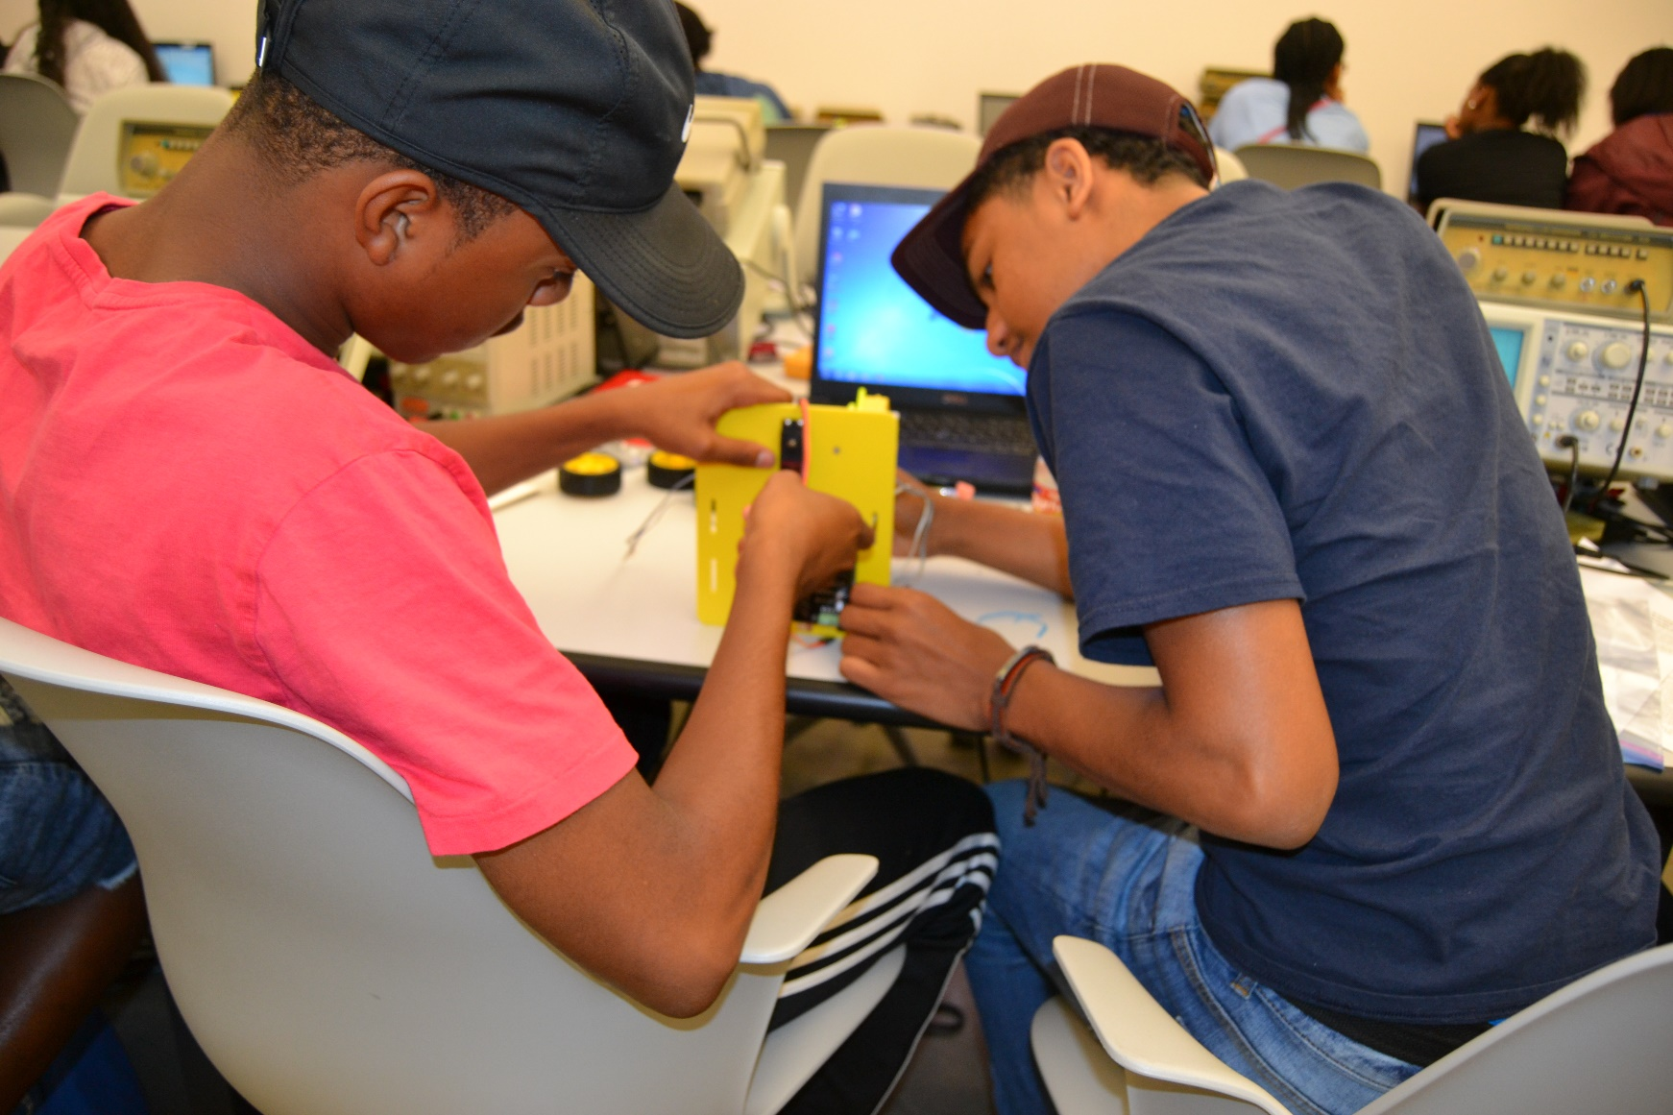
Building technical things…

Slide 13
STEM and Mechatronics
STEM - interdisciplinary approach to learning
Academic concepts are coupled with real-world lessons
Students apply science, technology, engineering, and mathematics in contexts
Make connections between the classroom and the world around them.
Mechatronics – interdisciplinary field that combines elements of engineering, machining, information technology, robotics, and electronics.

Slide 14
Describing Arduino
Arduino is an open-source electronics platform based on easy-to-use hardware and software.
Arduino boards capable of reading inputs - light on a sensor, a finger on a button, or a Twitter message - and turn it into an output - activating a motor, turning on an LED, publishing something online.
Tell your board what to do by sending a set of instructions to the microcontroller on the board. We use the Arduino programming language (based on connections – inputs & outputs), and the Arduino Software (IDE), based on Processing.

Slide 15
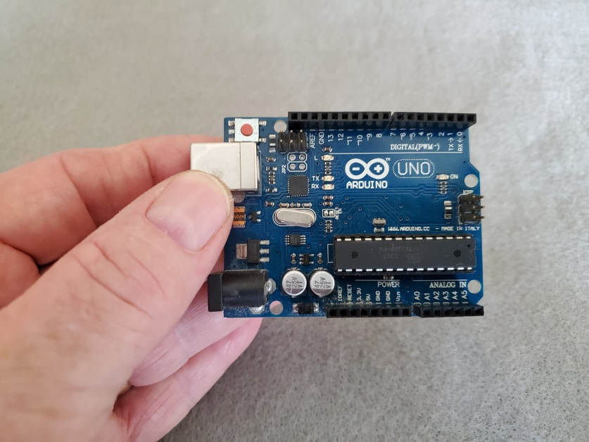
Arduino UNO
Programming
Jack
Digital
Inputs/Outputs
Analog
Inputs/Outputs
Small package… to do cool science & technology things!

Slide 16
Arduino & Science…
Arduino is a microcontroller … small computer! More later!
Tool to do cool things…
Programmable…
Very low cost…
Easy to use!
Versatile!

Slide 17
What can I do?
Even if you have only ONE!

Slide 18
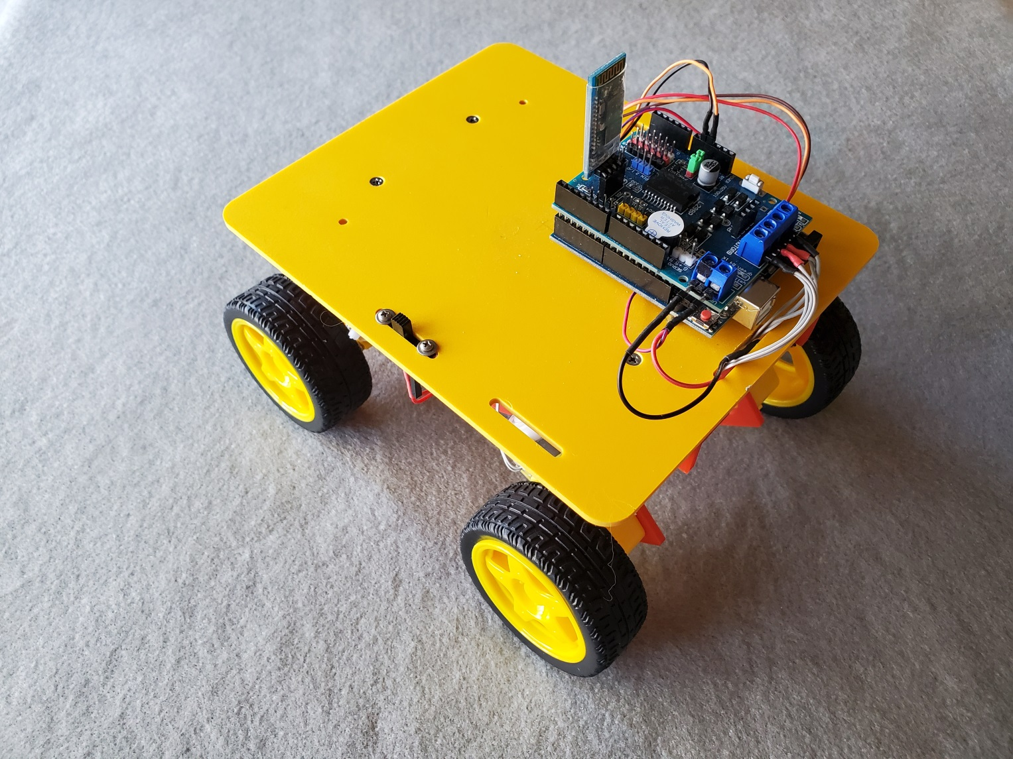
Build a Robot Rover…
Bluetooth
Radio
Battery
Motor
Shield
Arduino UNO
Rover
On/Off
Wheel
&
Motor
Gear Drive

Slide 19
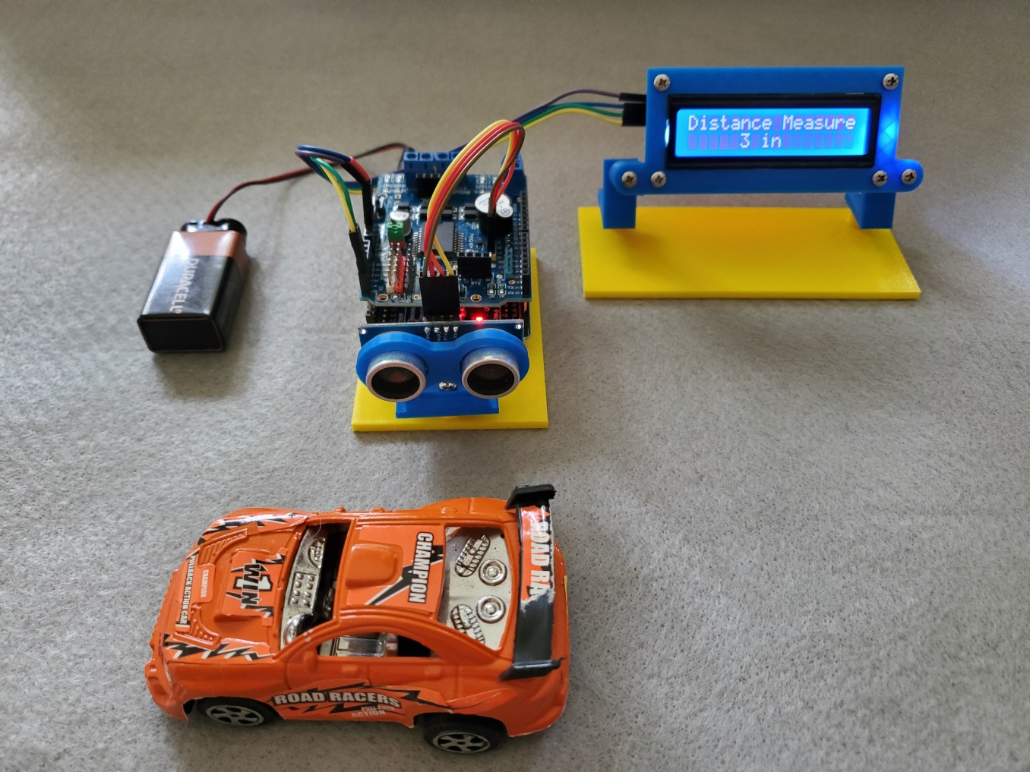
Things we can do… Sensors
Measure…
Distance
Temperature
Measure pH
Light
Motion – proximity…
Presence absence
Control a camera
Pressure

Slide 20
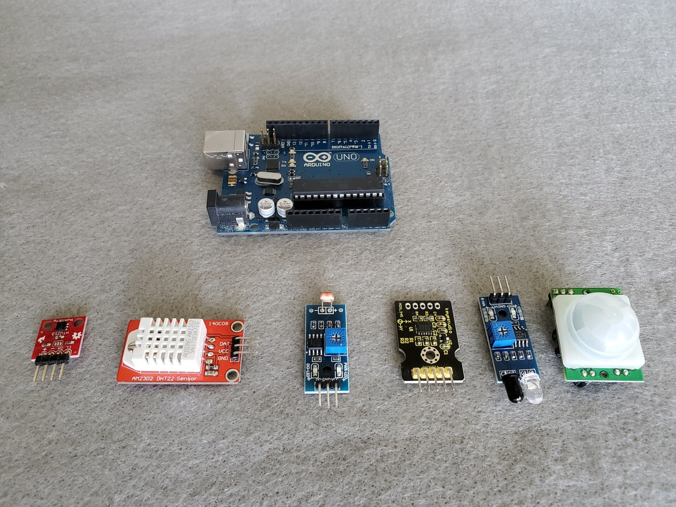
Sensors
Data collection
Storing data
Sampling
Solar Tracking
Moisture measure –
Plants & veggies
Photometer
Green house control
Hydroponics
Arduino UNO
Humidity
Temp
Light Sensor
Gyro
IR
Proximity

Slide 21
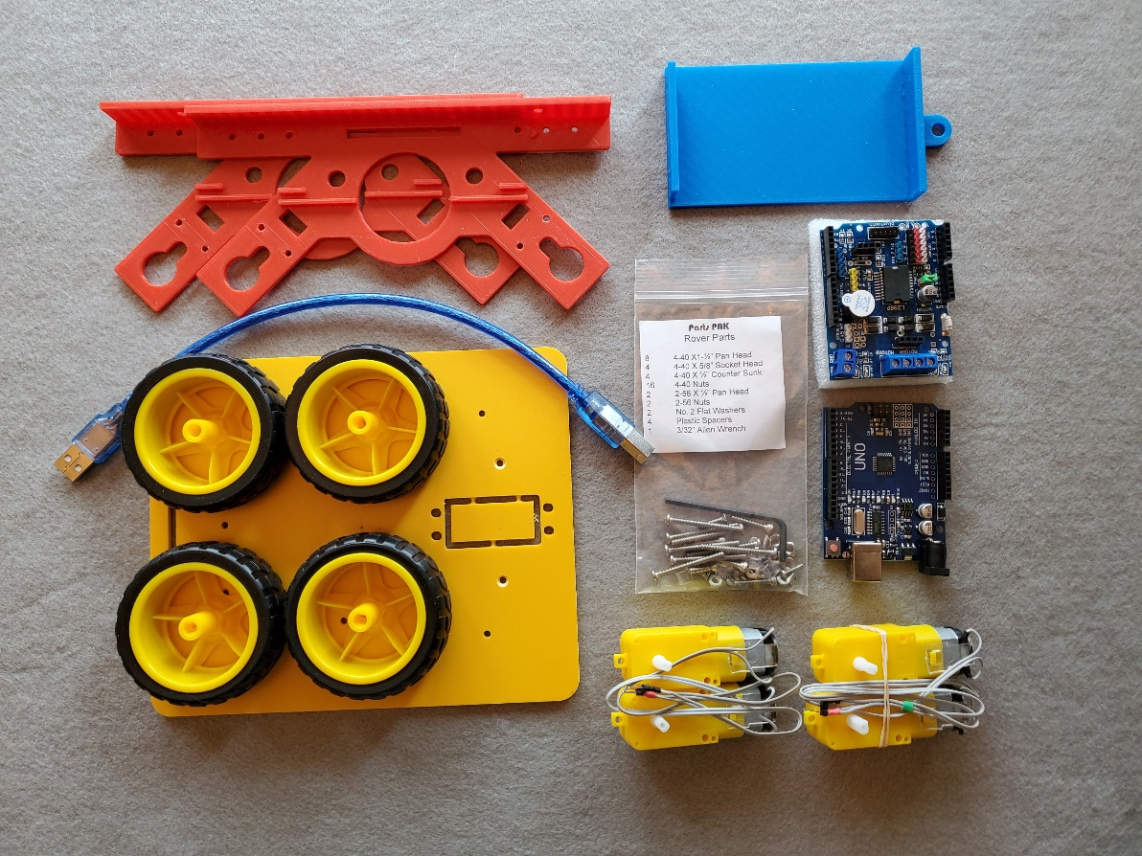
Printing Rover Parts & Assembly

Slide 22
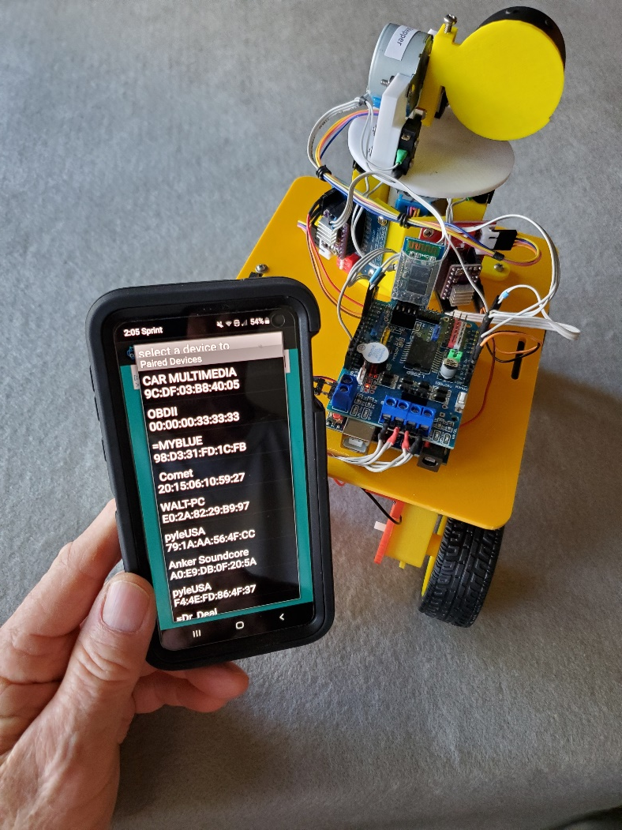
3D printing – Fabrication Coding, Testing, & Operation
Using smart technology as a communication tool…
Smart phones can do amazing things!

Slide 23
Working with Autodesk Inventor
What is Autodesk Inventor
Professional 3D mechanical design tool
Allow product development lifecycle & Cloud management & enable assembly reconfigurations!
Easy to start & powerful for professional 3D design!

Slide 24
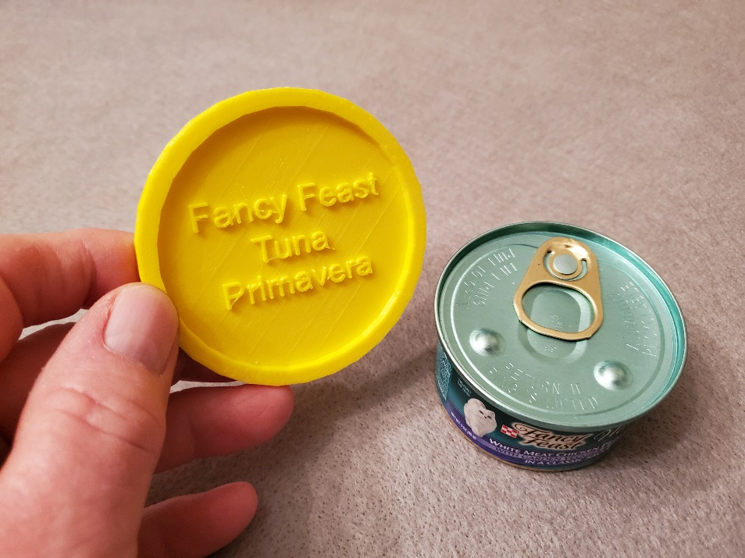
What is 3D Printing…
Processes used to create a three-dimensional object in which layers of material are formed under computer control to create an object.
Additive process – building by adding material
Produced from 3D model or data
3-D printed pet food can cover

Slide 25
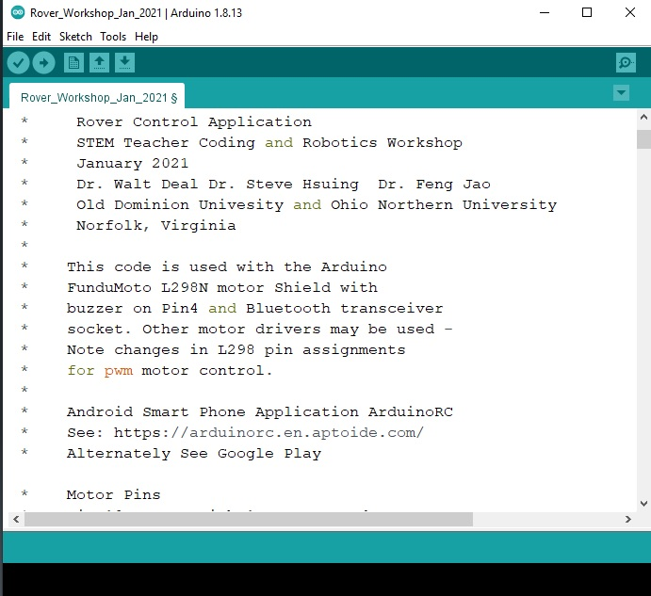
Programming Arduino UNO

Slide 26
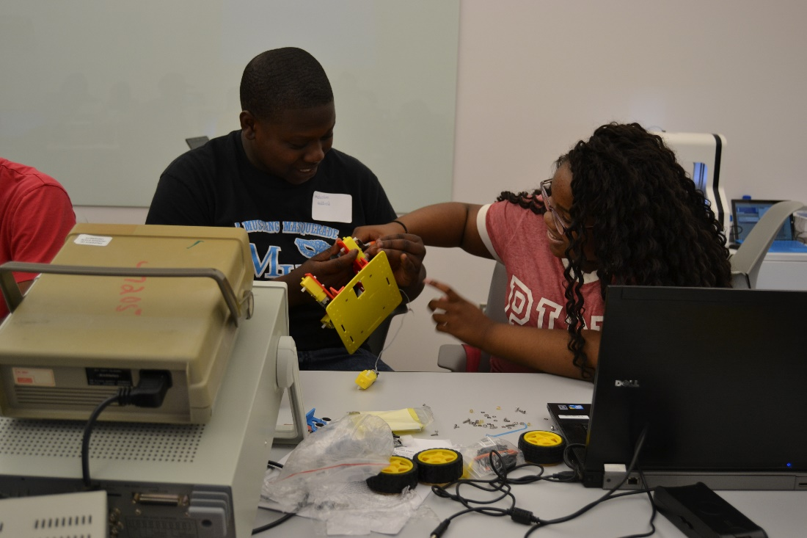
Team Skills
Why team skills are important
Improve productivity
Diversity of ideas & solutions
Expand learning experiences
Building work skills for success

Slide 27
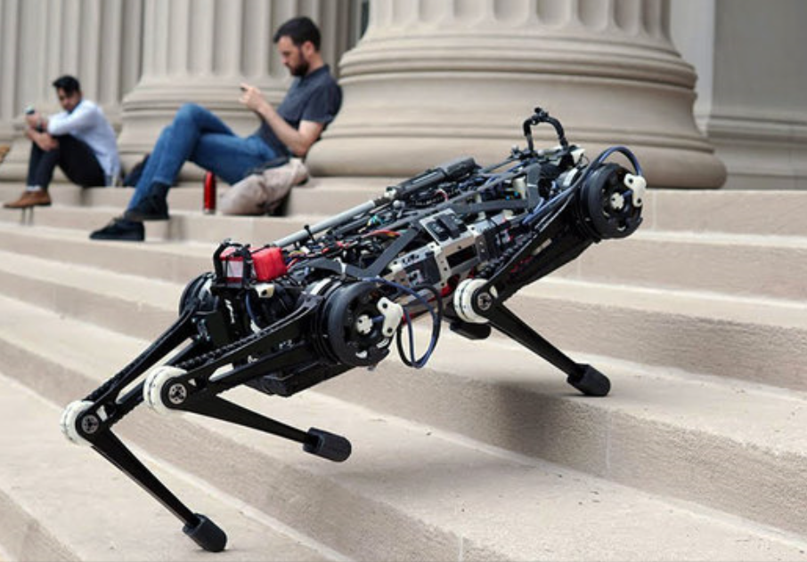
What is a robot?
A robot is a machine—especially one programmable by a computer— capable of carrying out a complex series of actions automatically.

Slide 28
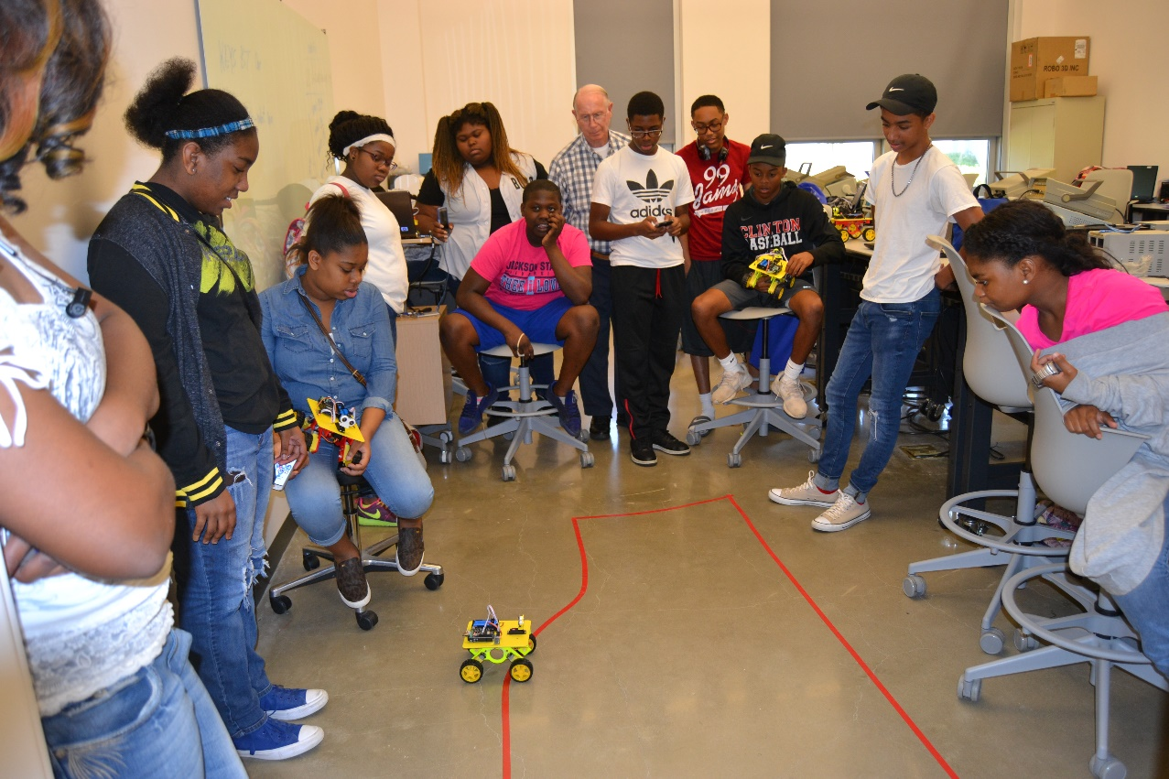
Cool things - Motion, Mechanics & Electronics

Slide 29
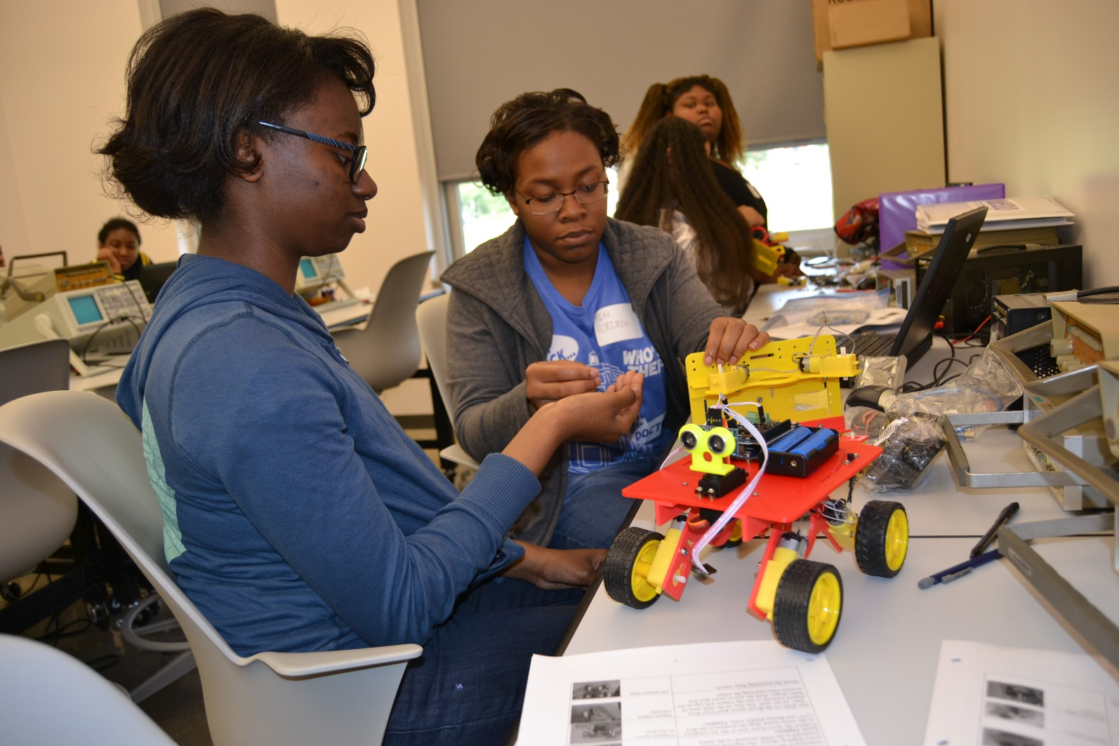
3-D printing – Fabrication Coding and Testing

Slide 30
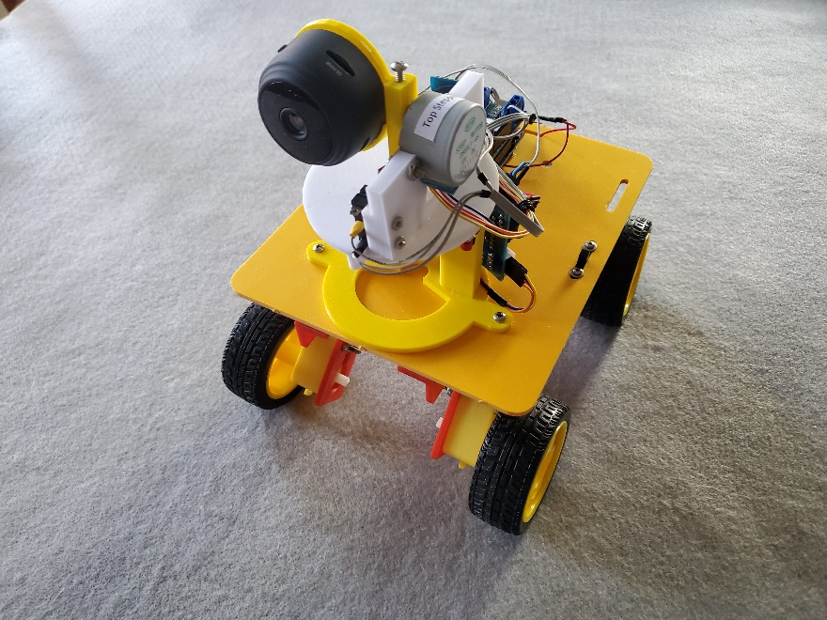
Rover Project
Bluetooth Rover – Smart phone app provides remote human control…
Vision system to find your way…
Flexible & expandable for challenging STEM activities
Build enthusiasm & interest in STEM and FUN to do!

Slide 31
Programming Robot Rover
The Code – C+ like language
Create and write
Compile and test
Upload to Arduino and run
Not scary!

Slide 32
Education and Careers
Technical – Medical – Agricultural - Construction
Technology
Math and Science
Engineering
Apprenticeships, Community College, & University
Military service

Slide 33
Looking ahead…
We are looking forward to …
Challenging STEM activities…
Problem solving…
ZOOMing with hands-on activities…
Fun, excitement and meeting new friends!

Slide 34
Where to find us:
ODU: Steve Hsiung, shsiung@odu.edu,
(757) 683-4606
ODU: Walt Deal, wdeal@odu.edu, (757) 928-5454
ONU: Feng Jao, f-jao@onu.edu, (419) 772-2172

Slide 35
Web Site Overview
Link to Web site
http://www.ucdistancetraining.org/index.html

