Slide 1

Career Perspectives
Creating Awareness & Interest
Jackson State University

Slide 2
What we are going to do…
Identify STEM career areas and pathways
Explore STEM related careers and other opportunities
Preparation…
  Non-completer – leaving high early
  High School graduate
Pathways to the future…
  Entry level employment with training or without training
  Community College programs
  Certificate programs – Technical – Medical - Professional
  Apprenticeship opportunities
  College/University programs

Slide 3
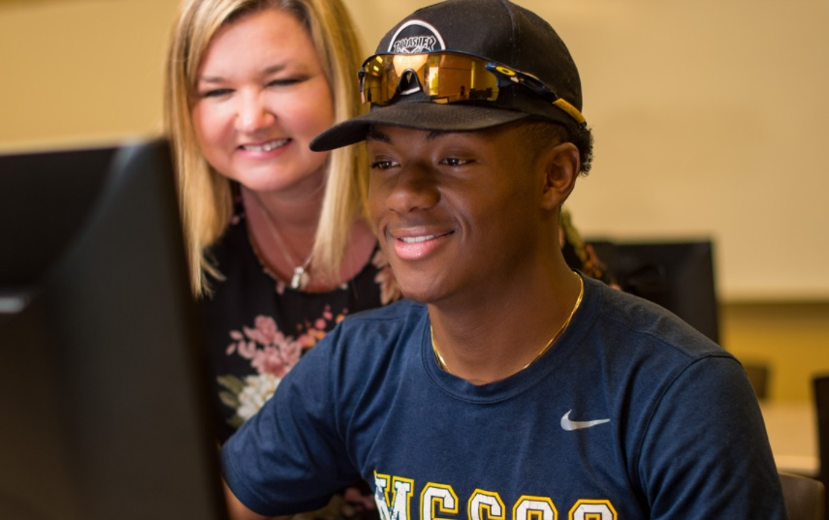
Career things…
The future is bright

Slide 4
Career Explorations…
6. Engage with STEM industry and business professionals.
c. Arrange a field trip, professional visit, or virtual interaction with a STEM professional and inquire about:
  i. Career fields and availability (considering automation trends)
  ii. Education and training
  iii. Certifications
  iv. Average salaries
  v. Job descriptions and daily tasks
d. Complete a reflective writing exercise that includes career
interests and document in the course portfolio.
See: Mississippi Department of Education
2019_stem_applications.pdf (mdek12.org)

Slide 5
Career Opportunities I Found…
Automation Technician – Peco Foods, West Point, MS 1 year electrical maintenance – Reading electrical drawings
Telcom Installation & Repair – Calhoun, MS
Fiber Technician – Greenwood MS
Quality Lab Technician – Landau Uniforms – Olive Branch, MS
County Program Technician – FSA Office Tylertown, MS
Assembly Technician Tempur Sealy – Belmont, MS
Wire Technician AT&T Carriere, MS
Installation Technician AT&T Carriere, MS
Health Technician (TeleHealth) Jackson, MS
These jobs pay anywhere from $13/hr to $1,700 per week
HTTP://www.indeed.com/q-Technician-l-Mississippi-jobs.html

Slide 6
Career awareness begins early…
COVID-19 places new challenges for teachers & students in a remote setting…
Hands-on STEM manipulatives are engaging – touching, feeling, building and testing
Middle School Opportunities – Build interest and enthusiasm in STEM areas, activities and careers
Simple fun activities that highlight ideas, concepts & exploration
ZOOM Team Pals – working together on common project
High School Opportunities – Robotics, coding and programming, 3-D printing, designing and construction – career directions

Slide 7
Career exploration activities…
Opportunity for individual students to examine career options that match their interests and aptitudes
Opportunity for students to learn about what people do for a living and to learn more about the demands of the workplace
Help students set career goals
Improve the attitudes of students toward their career opportunities
Improve academic performance

Slide 8
Career Perspectives – STEM Activities
College and Career-Ready Standards
The College and Career-Ready Standards emphasize critical thinking, teamwork and problem-solving skills.
Students will learn the skills and abilities demanded by the workforce of today and the future.
Mississippi adopted Mississippi College- and Career Ready Standards (MCCRS) because they provide a consistent, clear understanding of what students are expected to learn so that teachers and parents know what they need to do to help them.
2019 STEM Applications Mississippi Dept of Education

Slide 9
STEM Aspirations Study
With the large number of Science, Technology, Engineering, and Mathematics (STEM) jobs across the nation and state which are unfilled due to lack of interested and qualified STEM applicants, there is a need for more students to leave high school, enter college in STEM majors and continue through the STEM pipeline to STEM careers.
The purpose of this study was to determine the degree to which high school students who participate in a STEM program from elementary through high school aspire to STEM careers compared to students with similar mathematics achievement who did not participate in the STEM program.
Of particularly interest was the effect of the STEM program on female aspirations toward STEM careers.
Career aspirations was self-reported one month before students graduated from high school on a school and graduates of the STEM program were compared to graduates with the same gender and a similar mathematics test score.
The quantitative, retrospective study found that 58.75% of the students in the STEM program aspired to STEM careers after high school compared to only 40.00% of students with similar academic achievement that were not in the STEM program. (Source)

Slide 10
Community College Opportunities
Mississippi Community Colleges
Mississippi’s community colleges offer workforce training for businesses & individuals with the goal of providing a loyal and productive workforce for participating companies.

Slide 11
Community College Resources
Community College System
Explore MGCCC's STEM Programs (Link)
Career & Technical Pathways and Programs Agricultural, Construction, Manufacturing, Transportation (Link)
Workforce Training
Mississippi’s community colleges also offer basic work skills, advanced work skills, pre-employment training, safety and health training, short-term training, retraining, upgrade training and rapid response training.
East Central Community College: Workforce Development
East Mississippi Community College: Workforce Services
Holmes Community College: Workforce Development
Itawamba Community College: Workforce Development
Northeast Mississippi Community College: Division of Workforce Training and Economic Development
Northwest Mississippi Community College Workforce Development

Slide 12
Career side note…
US population is growing
Americans are getting older…
Healthcare needs are increasing
Healthcare careers and employment are booming
STEM activities and career awareness activities can highlight good career opportunities in rural and city settings
2020 top healthcare careers – physical therapist, dental hygienist, physician assistant, nurse practitioner, physician, registered nurse, occupational therapist, home health aide, licensed practical nurse, dental assistant, medical lab technician…

Slide 13
Work Based Learning
Work-based learning (WBL) is an effective teaching approach
Engages students in real-life occupational experiences, allowing them to connect the knowledge and skills learned in class to the workplace.
WBL provides students the opportunity to engage and interact with employers while learning to demonstrate essential employability and technical skills necessary for today’s workforce.
Resource

Slide 14
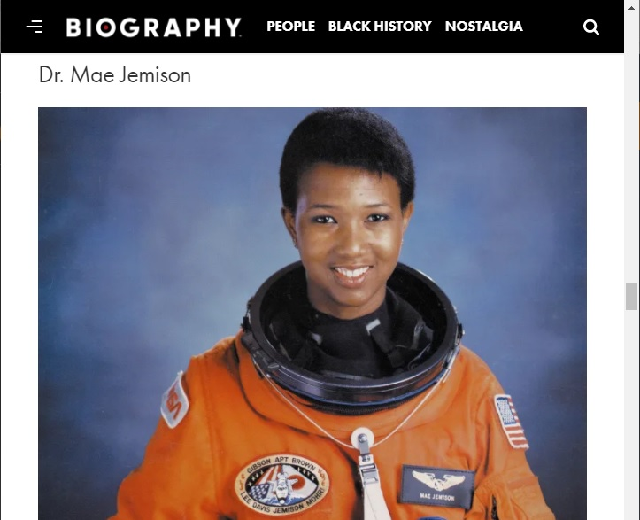
Astronaught…
Dr. Mae C. Jemison is an American astronaut and physician who, on June 4, 1987, became the first African American woman to be admitted into NASA’s astronaut training program. On September 12, 1992, Jemison flew into space with six other astronauts aboard the Endeavour.
Retrieved: January 26, 2021, Biography.

Slide 15

How Technology is changing the way we do things…
How Tech Opportunities are energizing towns across the US
Reegan Ford in Cheyenne, Wyoming (photo by Rachel Woolf)
Retrieved 1-25-2021 Microsoft Stories, Vanessa Ho

Slide 16
Career Connections with Arduino
Problem solving – defining a task
Critical thinking – developing strategies
Writing & communication skills – sharing info
Programming & coding competencies
Application of mathematics & technology concepts
Developing & using team skills – in class and tele-teams
Relevant hands-on activities – tools, materials, vocabulary, manipulative skills… work skills
Applying concepts by doing…

Slide 17
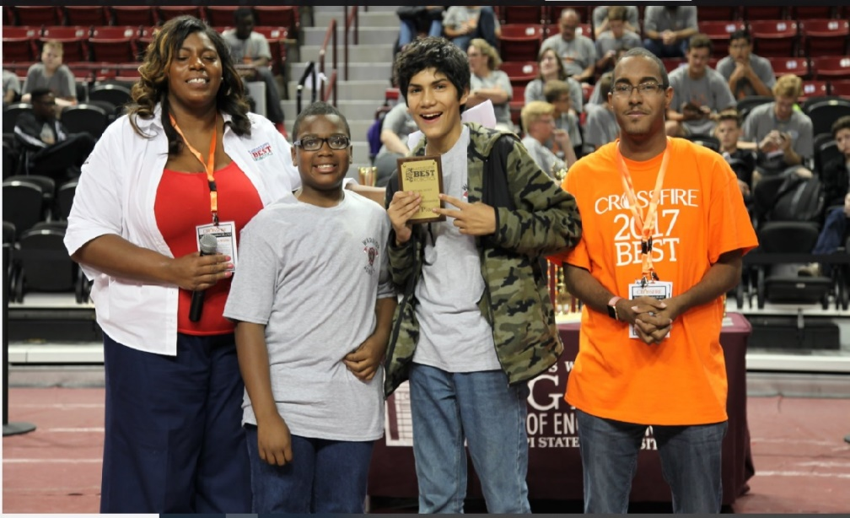
Team Skills
Why team skills are important
Improve productivity
Diversity of ideas and solutions
Expand learning experiences
Reflective of the World of Work
Building skills for success
Mississippi BEST

Slide 18
Resources
wbl_teacher_resource_guide_august_2020.pdf (mdek12.org)
Blacks in Technology (BIT)
USAToday – Influential Blacks in Business
Black Career Women’s Network (BCWN)
Mississippi Jobs Available (SimplyHired)
Official US Government Jobs (USAJOBS)

Slide 19
Summary
Career interest starts early… capitalize on it!
Pathways to the future – planning – preparation
  Entry level work training
  Certificate & community programs
  College – university STEM programs
Healthcare – many opportunities
Team skills – key part in todays workforce
STEM career awareness activities – interest & enthusiasm
Our goal is our student’s success…

