Slide 1

Mechatronics & Arduino: Coding & Testing
Jackson State University

Slide 2
What we are going to do…
Describe Mechatronics
Describe an Arduino
Use Arduino software to create simple programs
Program Arduino for Motor Driver check (Beep-Beep)
Program Arduino Robot Rover (Motor Test)
Test your programmed Robot Rover (Rover)
Participate in a virtual competitive event
Identify potential classroom STEM activities

Slide 3
What is Mechatronics?
A field of study that combines the fundamentals of Mechanical, Electrical, and Computer Engineering
Science that integrates mechanical devices with electronic controls
The interdisciplinary field of engineering dealing with the design of products whose function relies on the integration of mechanical and electronic components coordinated by a control architecture
Further…

Slide 4
Mechatronics… Blending of Technologies
The synergistic use of precision engineering, control theory, computer science, sensor, and actuator technology to design improved products and processes
Integration of electronics, control engineering, and mechanical engineering
Mechatronics is concerned with the blending of mechanical, electronic, software, and control theory engineering topics into a unified framework that enhances the design process

Slide 5

Mechatronics – cutting edge…

Slide 6
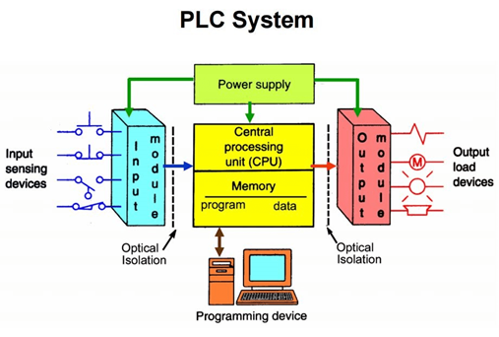
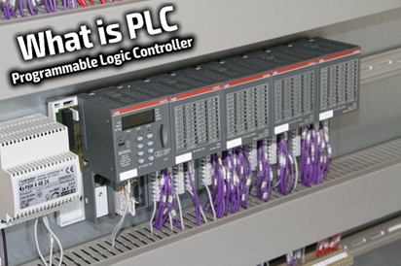
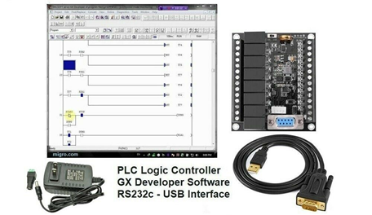
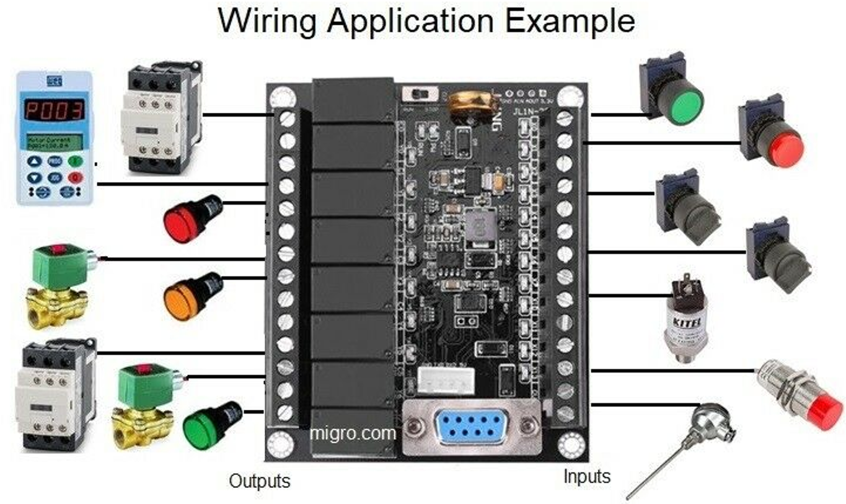
Combining Engineering Fields
PLC: Programmable Logic Controller with Ladder Logic

Slide 7
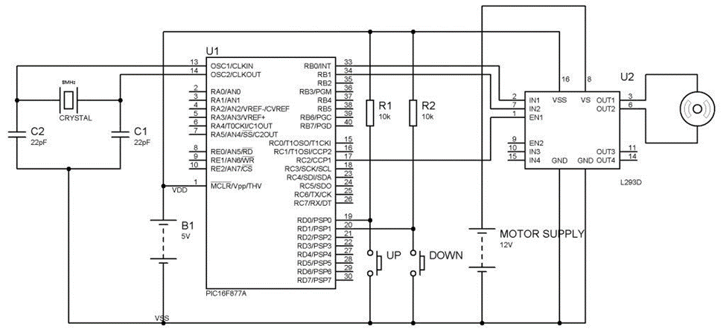
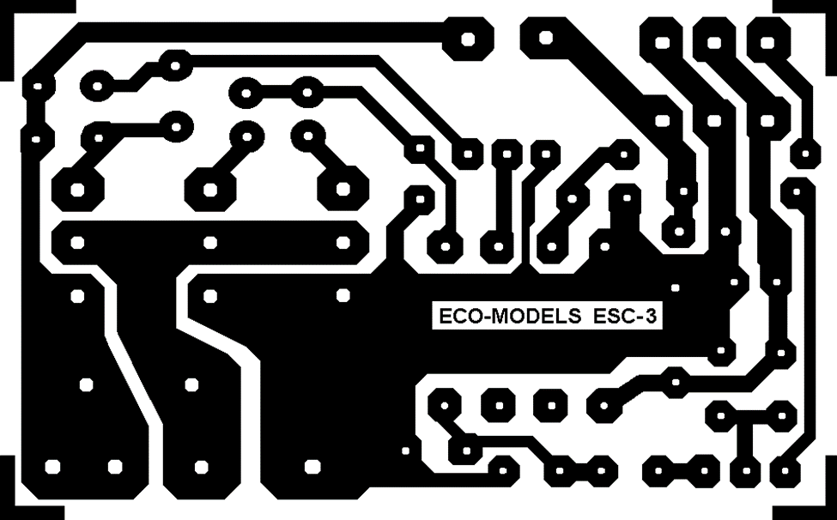
Engineering…
Schematic Diagram
Electronic Circuit Board

Slide 8
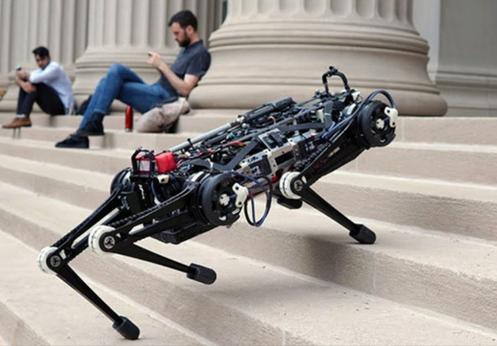
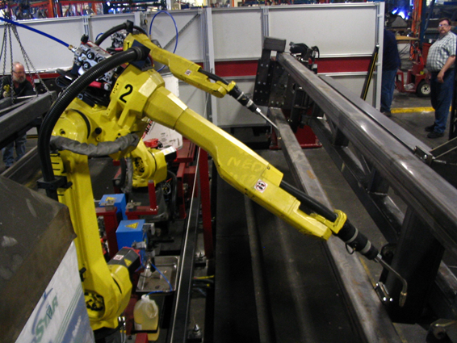
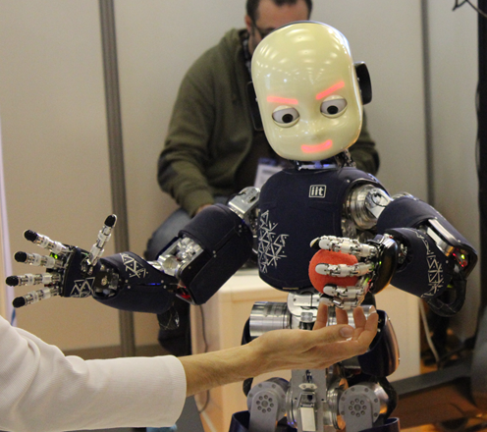
Engineering…
Pick and Place Robot
Human Interactive Robots

Slide 9

Engineering…
Pick and Place Robot
Human Interactive Robots

Slide 10
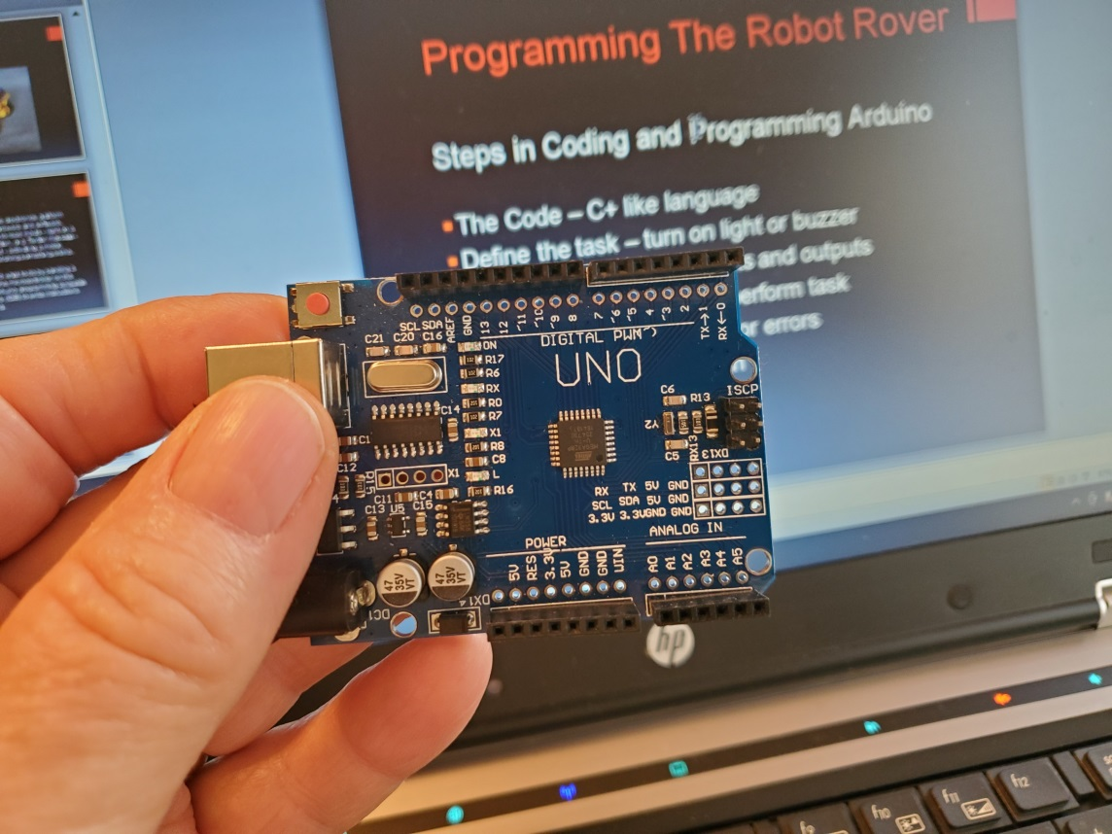
Arduino UNO
Arduino UNO – small versatile microcontroller platform for creating designs, projects and STEM activities.

Slide 11
What is Arduino?
Arduino is an open-source electronic microcontroller platform based on easy-to-use hardware and software.
Arduino boards can read inputs - light on a sensor, a finger on a button, or a Twitter message - and turn it into an output - activating a motor, turning on an LED, publishing something online.
You can tell your Arduino what to do by sending a set of instructions (program) to the microcontroller on the board. We use the Arduino programming language and Arduino Software (IDE) to write instructions based on Processing.

Slide 12
Getting Started
Resources - Computer with Arduino IDE installed, USB cable, Arduino UNO
    Open the Arduino IDE application
    Plug USB cable into Arduino USB port
    Plug USB cable into computer USB port
    Menu Bar – select Tools – Note “Board” and “Port” settings

Slide 13
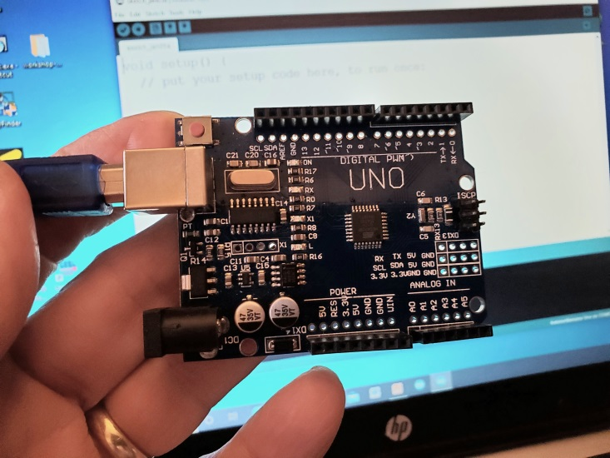
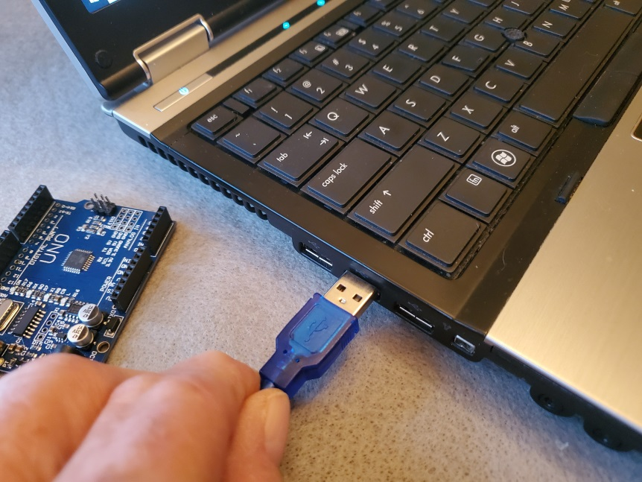
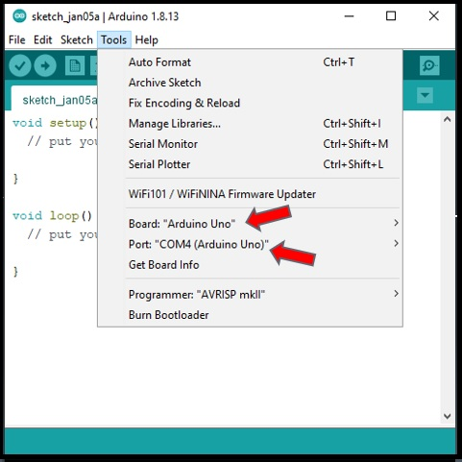
Connecting Arduino
1 - Insert USB Arduino
2 - Insert USB computer
3 – Check Board & Port

Slide 14
Programming Arduino
Steps in Coding and Programming Arduino
Define the task – turn on light or buzzer
Identify the process – inputs and outputs
Create and write code to perform task
Compile code and check for errors
Upload code to Arduino and…
Run your program!
Note: The Code we write is a C+ like language

Slide 15
Working with Arduino…
Coding
Getting started…
Planning your project and coding
Hardware and software – Arduino – IDE software
Define the task – To blink a light
Light ON 1/2 second – Light OFF 1/2 second
Repeat the process (This is called loop)

Slide 16
What is Arduino IDE
Arduino Integrated Development Environment
Specialized word process – called an editor
Write and edit text
Includes tools - “copy & paste” “find & replace”
Can communicate with an electronic device (Arduino)
Process code/instructions into machine language – compiling
Check for errors in coding
Transfers instructions/code to Arduino (upload)
Opening the IDE will open the last program edited or a NEW template screen – See the next slide as an example.

Slide 17
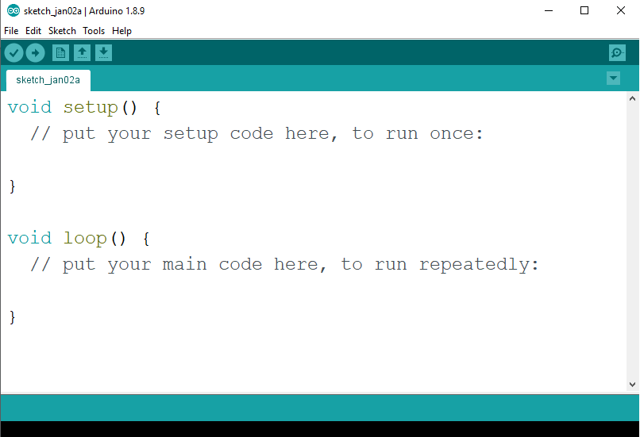
Arduino IDE
IDE – Integrated Development Environment
Menu Bar – File Edit Sketch Tools Help

Slide 18
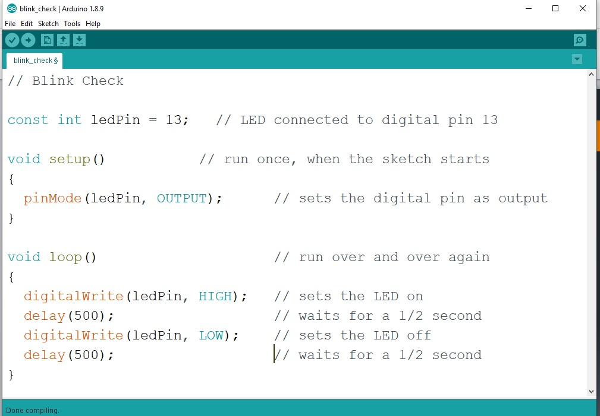
Blink LED Code Example

Slide 19
Coding our first program!
Step by Step…
Have you installed the Arduino IDE?

Slide 20
Coding your first program
Turn ON your notebook or desktop computer
Open the Arduino IDE App
Plug-in the programming cable to Arduino cable port
Plug-in the USB cable into a computer USB port
Windows 10 will acknowledge that Arduino is connected
The IDE App should recognize Arduino board & port
Alternatively – Choose TOOLS on menu bar
The App will recognize the Board (Arduino/Genuino UNO)
May need to select correct serial port (COM6, COM7…)
Open program file or begin coding your own file
Verify your program – fix errors if any
Upload and RUN your program

Slide 21
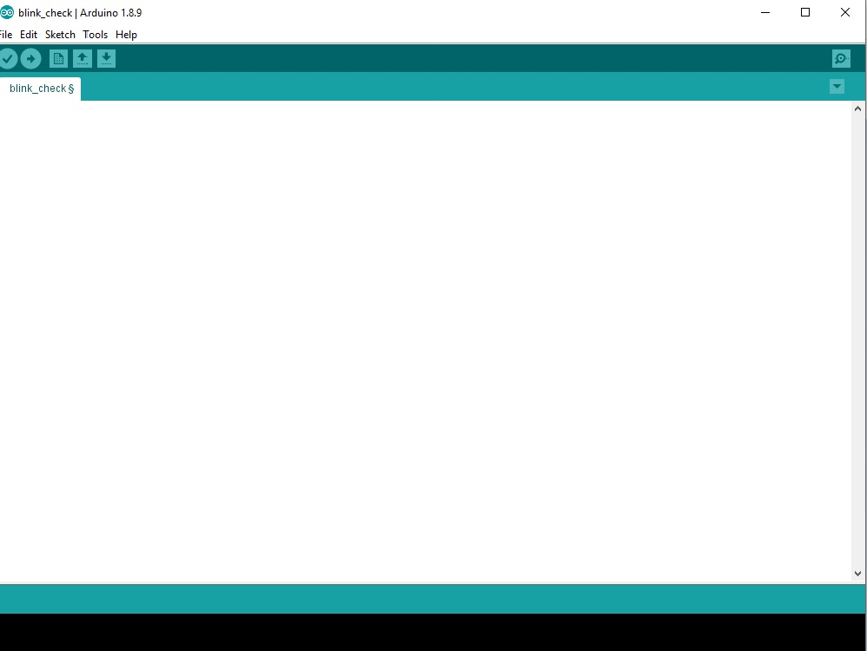
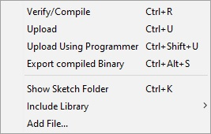
// Blink Check – This is a COMMENT line begins with //
const int ledPin = 13; // LED connected to digital pin 13
void setup() // run once, when the sketch starts
{
pinMode(ledPin, OUTPUT); // sets the digital pin as output
}
void loop() // run over and over again
{
digitalWrite(ledPin, HIGH); // sets the LED ON
delay(500); // waits for a 1/2 second
digitalWrite(ledPin, LOW); // sets the LED OFF
delay(500); // waits for a 1/2 second
}
End
Click

Slide 22
Summary
Describing Arduino (Link)
What is a program (Link)
Steps in Programming an Arduino Microcontroller (Link)
Writing your first program - Blink (Link)
Program Arduino Robot Rover – Motor Test
Test your programmed Robot Rover - Rover
Participate in a virtual competitive event - ZOOM
Identify potential classroom STEM activities

