Slide 1
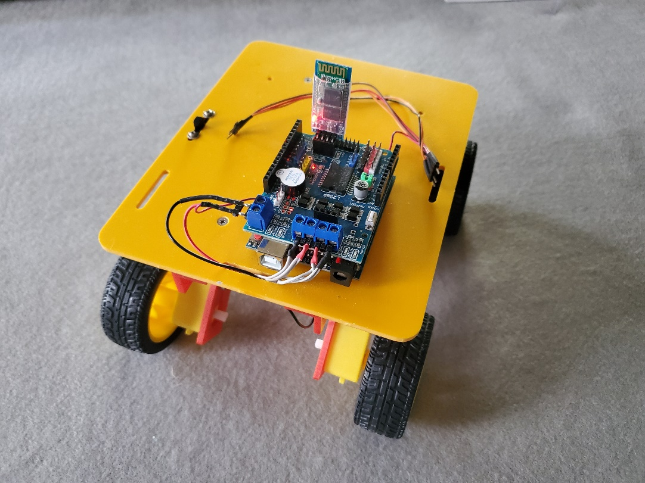

Rover Assembly
Jackson State University

Slide 2
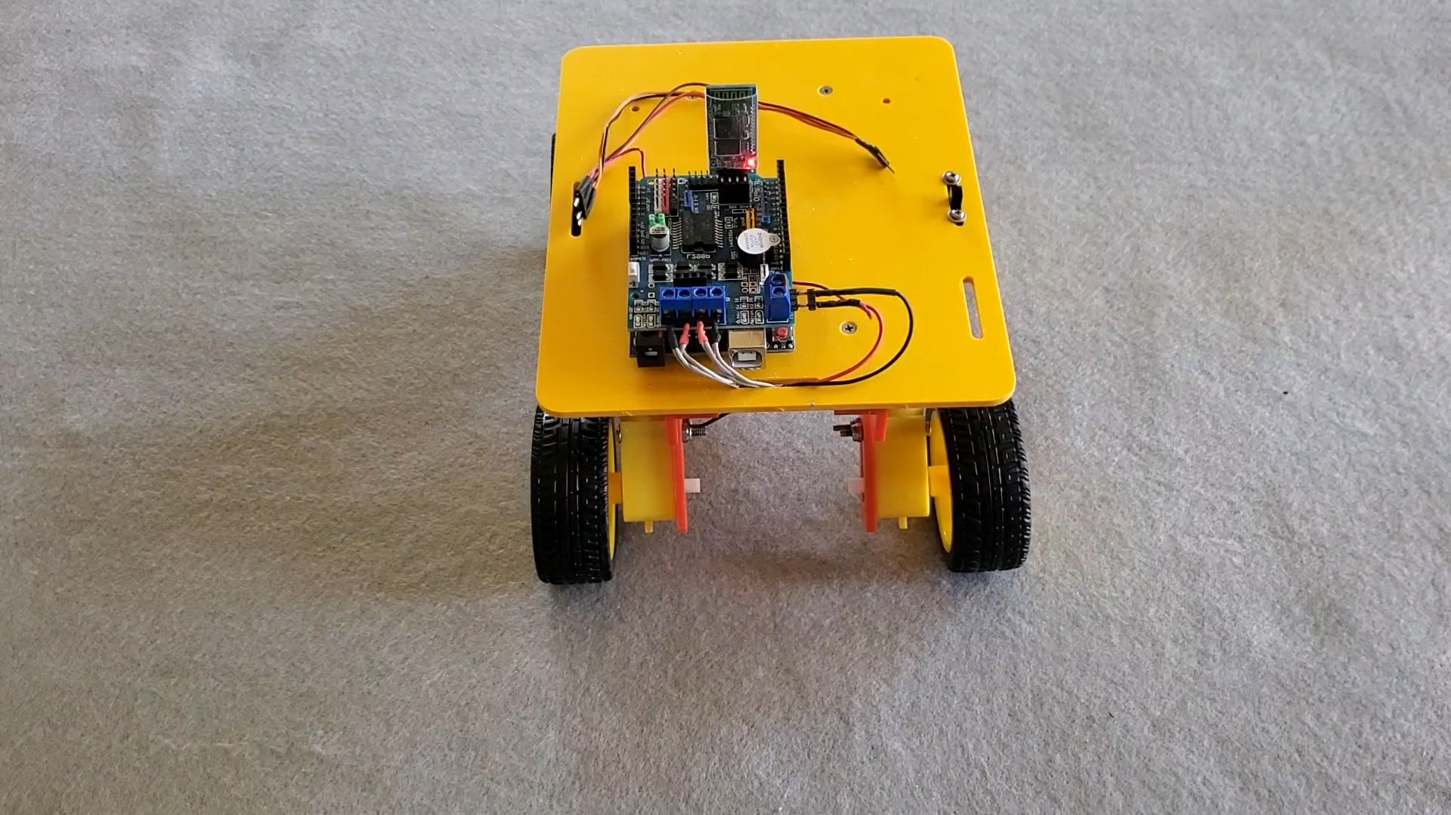
Rover Assembly
Jackson State University

Slide 3
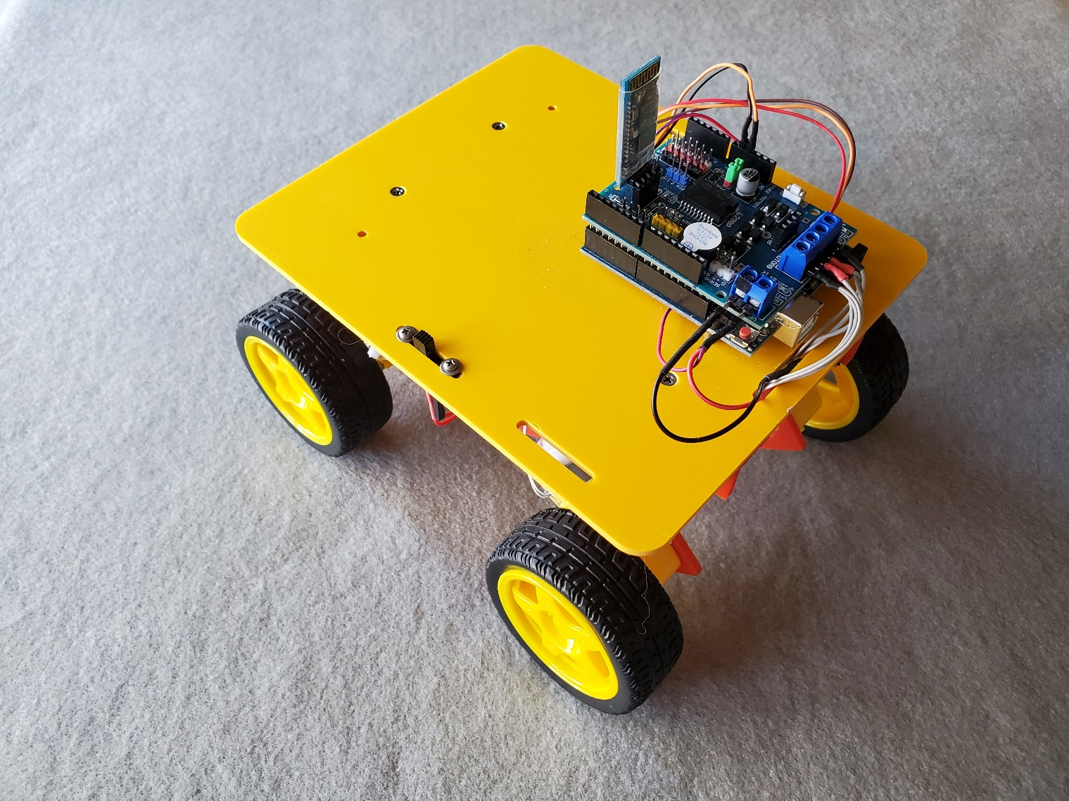
Assembled Rover
Driver Board
BT Radio
Platform
Power
Switch
Arduino UNO
Motor
Side
Brackets
Wheels/Motors

Slide 4
Getting Started
Where to start?
Best to have a convenient worktable …
Work surface large enough to accommodate Assembly Guide, parts & tools
Towel as a soft “work-area” mat (Keep parts from falling on floor!)
Tools needed – Phillips's screwdriver & needle nose pliers
Rover Fastener Parts package – screws, nuts, & 4-spacers
Rover parts – platform, 2-motor side brackets, 4-wheels, 4-motors, & battery tray
Electrical – Power switch, wire harness, Arduino UNO, motor driver board, & battery holder

Slide 5
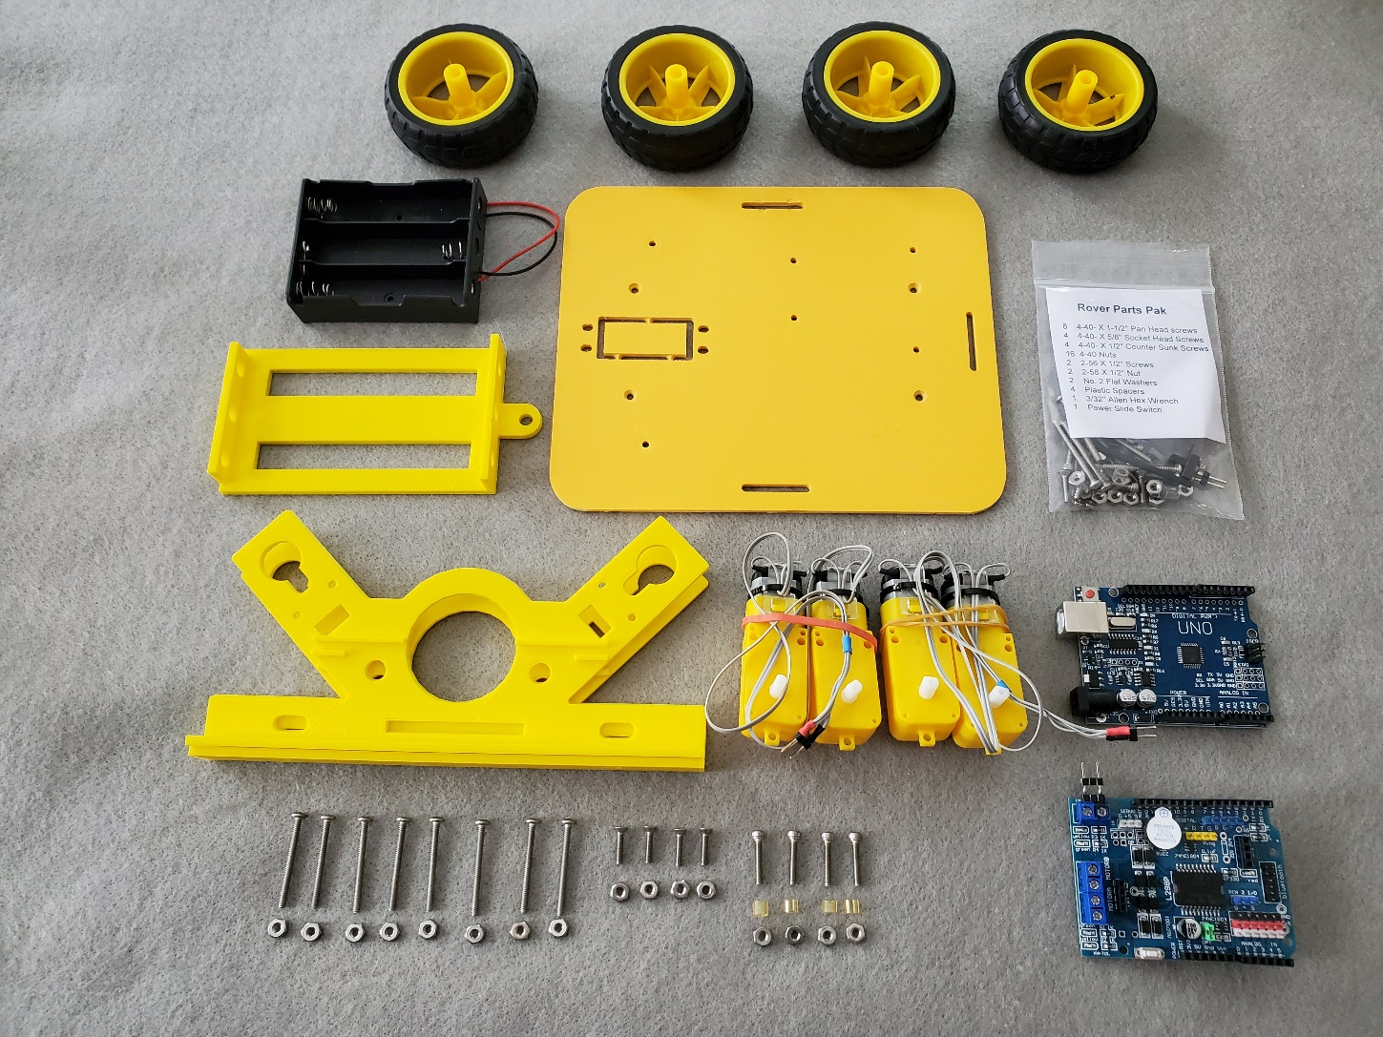
Parts Layout
Wheels
Rover
Platform
Battery Holder
Fasteners
Battery Tray
Motors
Motor Side
Brackets
Arduino
Motor Driver
Board
Long
Screws
Flat Head
Screws
Arduino
Screws

Slide 6
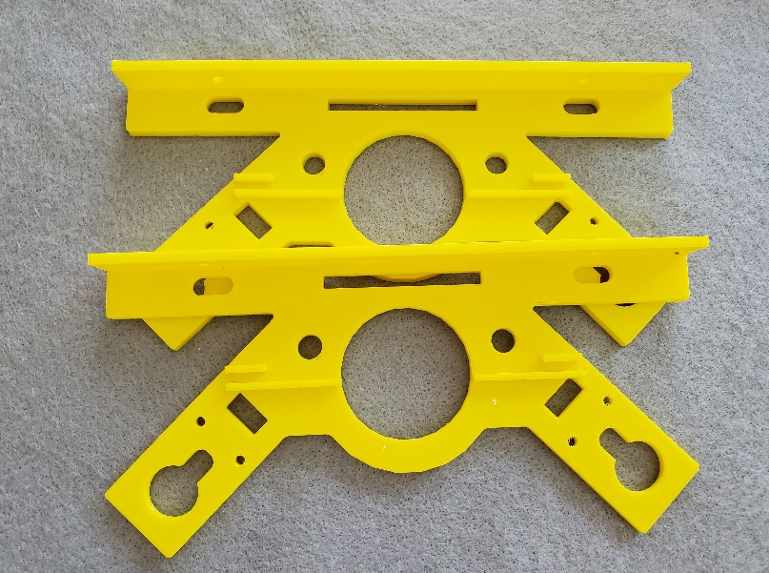
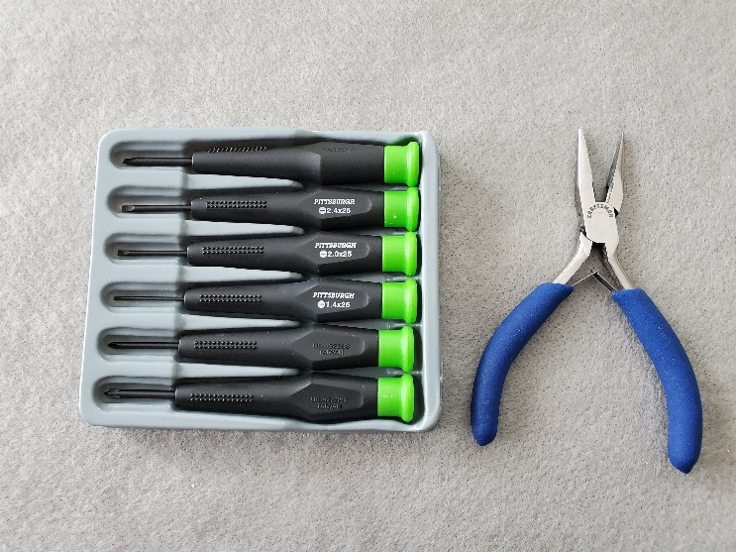
Attaching Motor Side Brackets
What’s needed…
Motor Side Bracket, 4 – ½ inch FLAT HEAD screws, 4 – nuts
Phillip’s screwdriver and needle nose pliers
Note orientation of bracket – mounting flange toward middle of platform
Do not over-tighten screws!

Slide 7
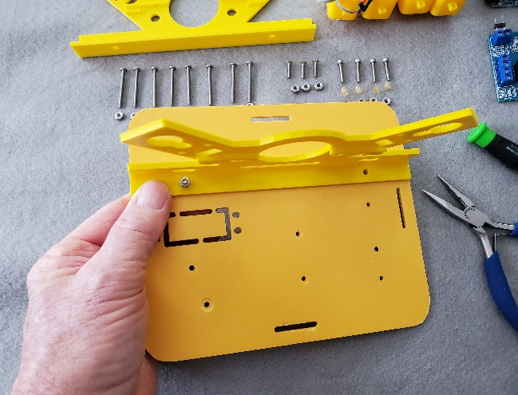
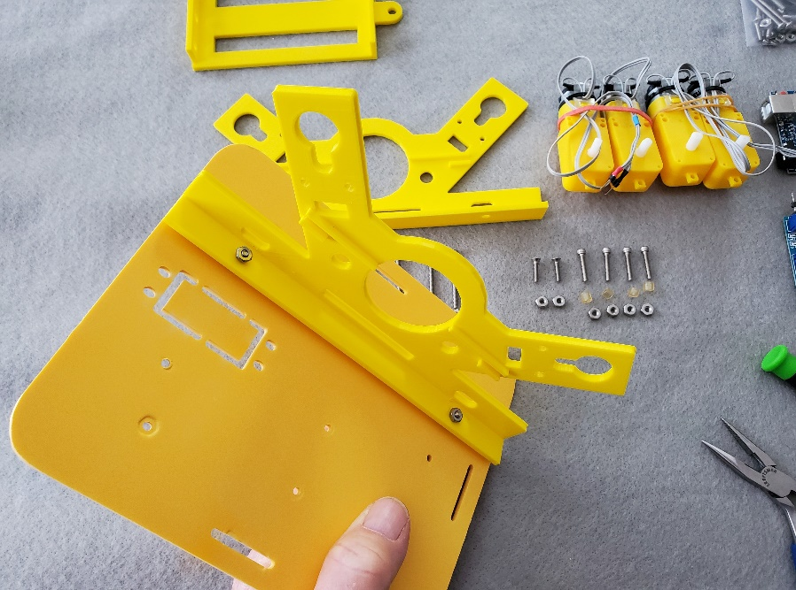
Attach Side Bracket
How to…
Insert flathead screw through platform & bracket
Screw nut on threads with fingers
Tighten lightly
Insert second screw & remaining screws

Slide 8
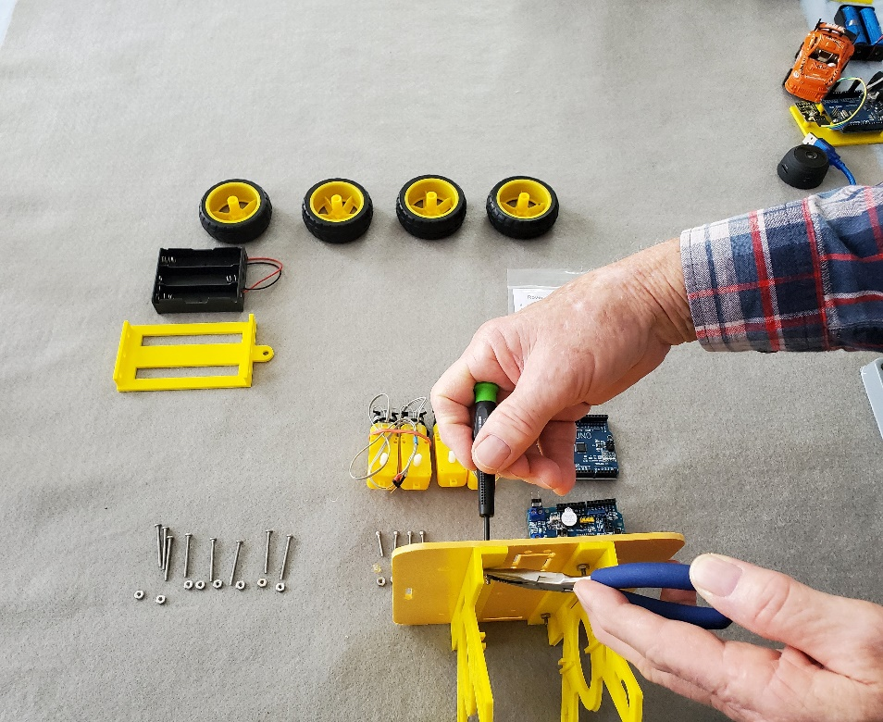
Attach other Side Bracket
Both motor side brackets are the same
Use remaining two FLAT head screws & nuts to attach other side bracket
Flange faces to center of platform
Tighten securely but do not over tightened

Slide 9
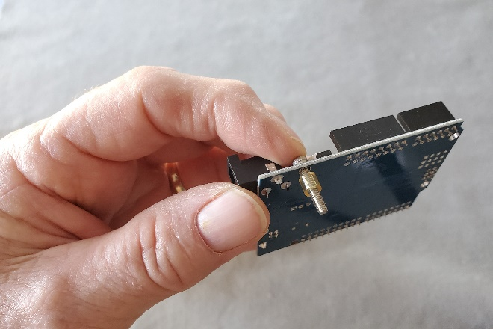
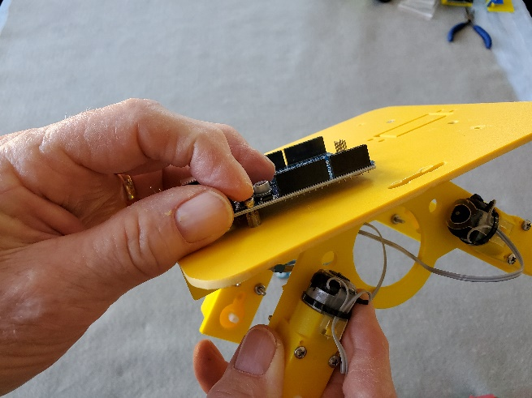
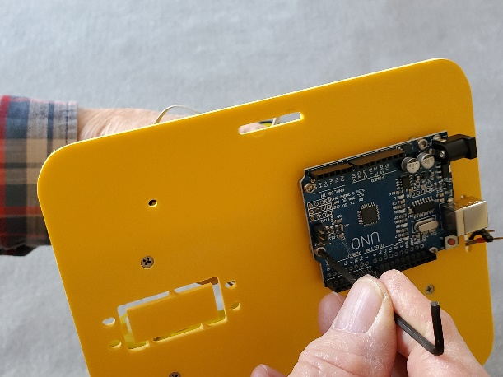
Attach Arduino UNO Board
Place socket screw through Arduino mounting hole with spacer on bottom
Place socket screw through platform mounting hole with spacer & nut on bottom side
Add remaining three screws, nuts & tighten lightly with HEX wrench…

Slide 10
Install Rover Drive Motors
What’s needed…
Two drive motor pairs , 8 – long screws (1-1/4 inch), 8 – nuts
Phillip’s screwdriver & needle nose pliers
Notes…
Each motor pair is mounted on the same side of the Rover side bracket
Motors are mounted with wires facing outward
Place 2 – screws through motor mounting holes – align with bracket – attach nuts on backside of motor bracket

Slide 11
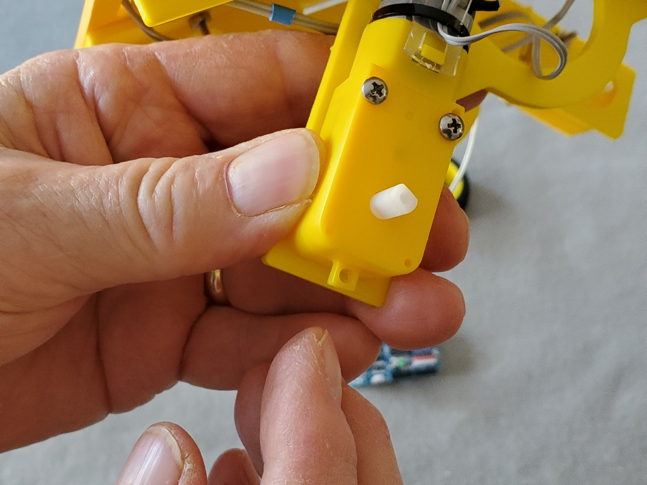
Mounting Drive Motors
What to do…
  Attach 4-drive motors
  Use 8-long screws (1-1/4 in) & nuts
  Motor wires face outward as shown
  Tighten with Phillip’s screwdriver and pliers
  Do not overtighten
Long Screws

Slide 12
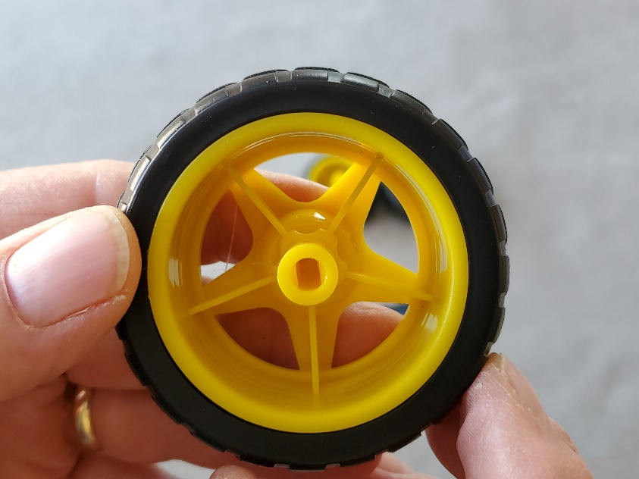
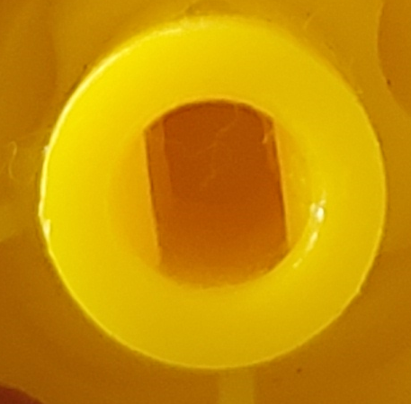
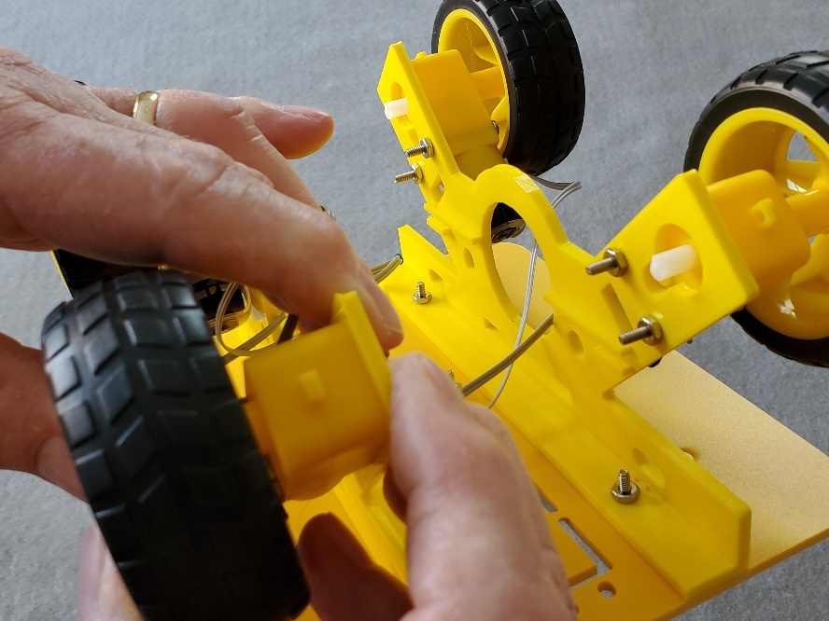
Attach Wheels
Note the shape of the
Axle hole in the wheel hub – Flat sides must align with motor axle!
Align wheel & axle and press together – may have to rotate wheel slightly – index fingers must support back side of motor and bracket

Slide 13
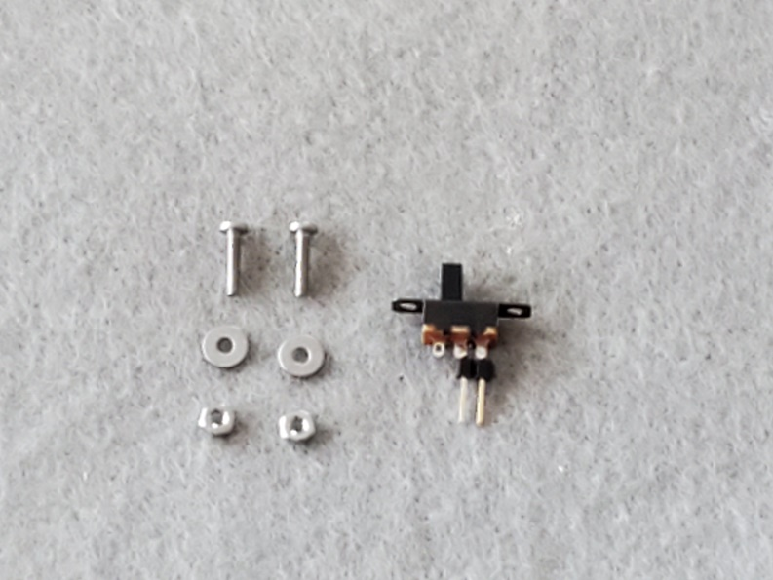
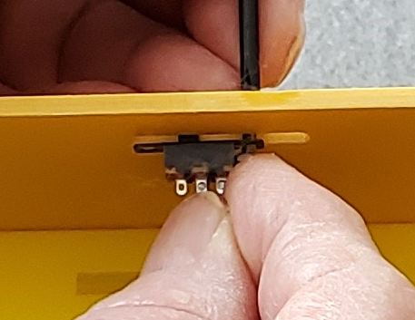
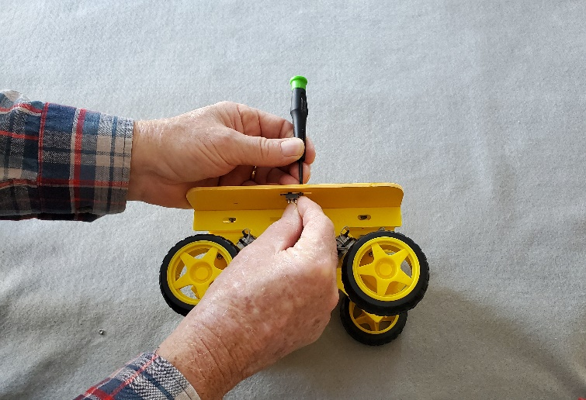
Install Power Switch
What to do…
Install power switch
Screws & washers on top
Switch and nuts on bottom
Parts
Small screws
Washers
Switch
Nuts

Slide 14
Summary
What we did…
  Check and review Rover part names
  Follow assembly steps…
  Assemble Side brackets to platform – left & right
  Install Arduino with socket screws & spacers to platform
  Attach driver 2 driver motor pairs – wires face out
  Attach 4 wheels – note “flats” on axle and wheel hubs – align & press on with fingers
  Install power switch with small screws, washers & nuts

Slide 15
Resources
Arduino Smart Car/Robots photos
Arduino RADAR
Prosthetic Hand
Egg Incubator
How Tall Are You? (Measure person’s height)
Binary Counter
AI & Machine Learning for Kids (Middle School)
Transformer's Baby: Arduino Avoiding Obstacle Robot
Search for High School Arduino Sensor Projects
Use SHIFT-click

