Slide 1

Sensing the World Around Us with
Arduino & Sensors
Jackson State University

Slide 2
Objectives
Identify the 5 human senses.
Describe or define a sensor.
List 5 examples of sensors.
Identify three sensors that cell phones have.
Describe a potential science - technology activity using sensors in the classroom .

Slide 3
Sensing the World Around us
What is a sensor?
Where are sensors used?
Sensors – Digital and Analog
What are several examples of sensors?

Slide 4
What are sensors?
Sophisticated devices used to detect and respond to electrical, optical, or physical properties…
Sensors convert a physical parameter (heat, light, temperature, blood pressure, speed) into a signal that can be measured electrically…
Sensors may sense a change in light, temperature, pressure or physical properties (chemical, biological)
Simply… an input device which provides and output (signal) with respect to a physical quantity (output).

Slide 5
Perspective - Sensory World
We live in a sensory world where our vision, sound, touch, feel and smell make lasting impressions of our awareness about the world around us.
Humans and other creatures alike employ a variety of physiological sensory organs and features that enable the navigation, perception of our unique environments, and survival.
In the human and animal world, there are the senses of sight, hearing, smell, touch, and taste.
We identify these senses as the five senses. As an extension of these senses, we can sense and differentiate temperature such as something that is cool or warm as well as a sense of balance and vibrations.

Slide 6
Do you know…
Someone with a pacemaker?
Someone who has a smart or sports watch?
Someone with a cell phone?
A digital camera?
A person with diabetes?
A person with a heart monitor or high blood pressure?
Family with a home security system?
A home heating and air conditioning system?
Other sensors… credit cards, thermometer, scales?

Slide 7

Recognize this…

Slide 8
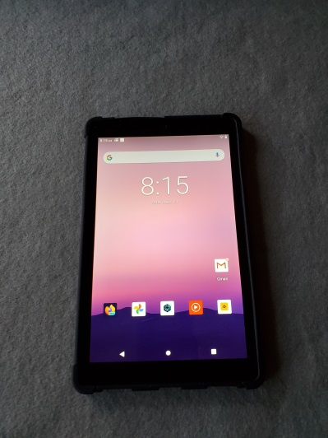
Smart Phone Sensors…
Capacitive Tactile – Touch
Microphone
Gyroscope – Tilt - Orientation
Accelerometer - Motion
Magnetometer - Direction/Compass –Navigation
GPS – Global Positioning System
Biometric – Touch – Fingerprint Scan
Infrared Sensor – Heat – Facial Recognition
Soli – RADAR – LiDAR (Light Detection & Ranging)
Barometer
Proximity
Ambient Light Sensor

Slide 9
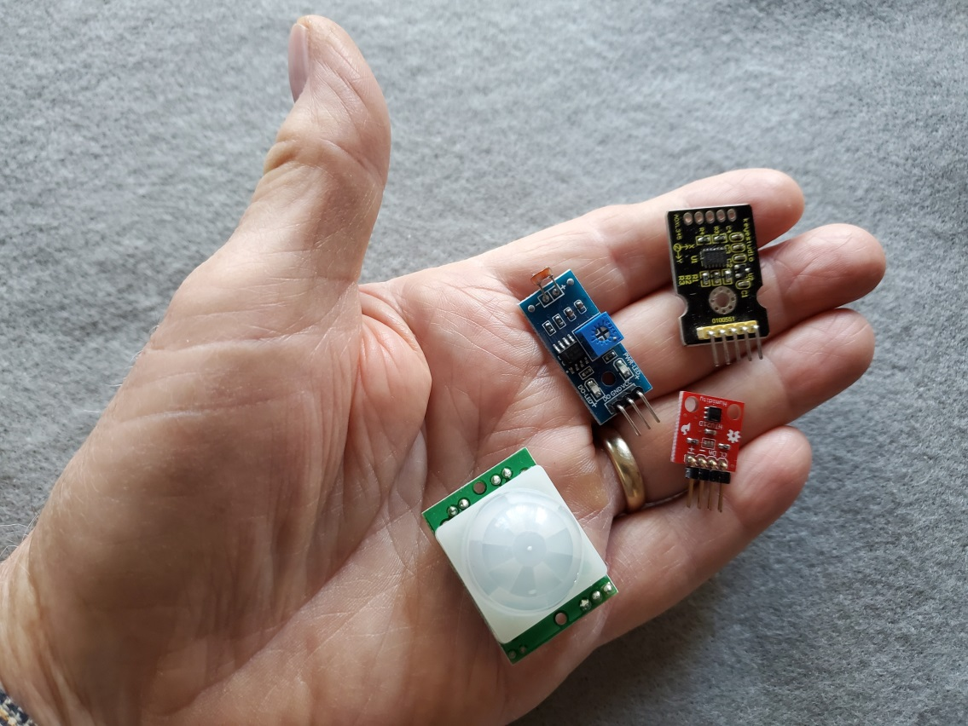
Sensor Examples
3-Axis Gyro
Light
Temp-Humidity
Proximity

Slide 10
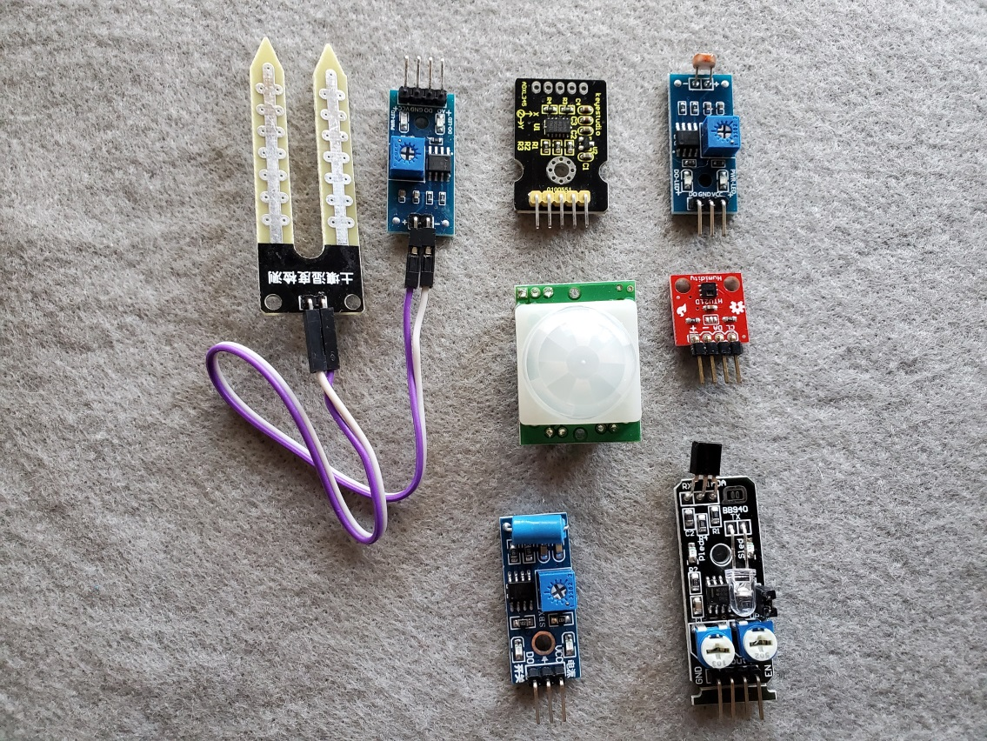
Other Sensors…
Moisture
Acceleration
Light
Gyroscope
Magnetic
Tilt/movement
Proximity

Slide 11
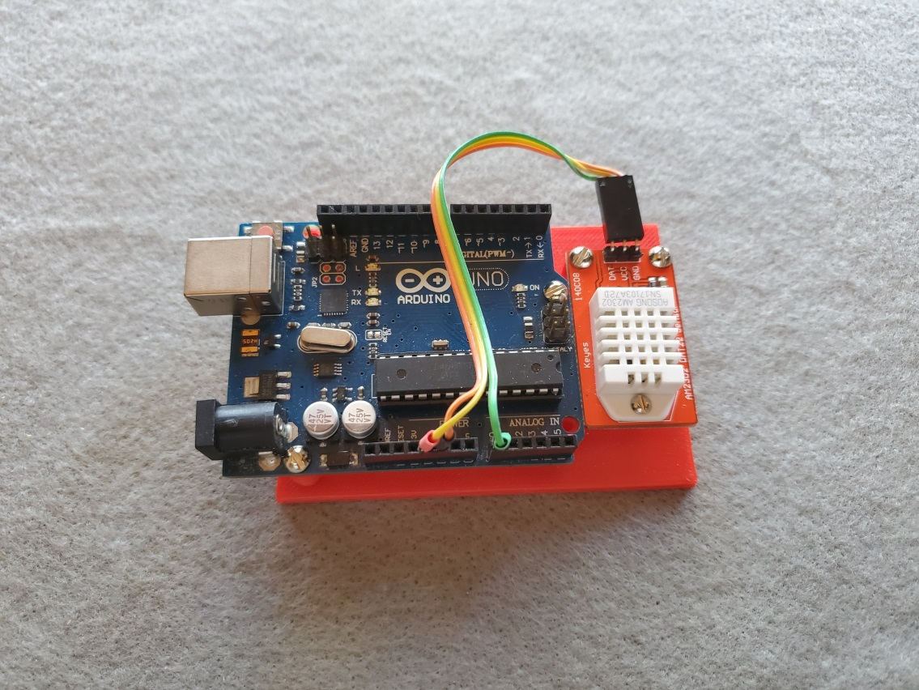
We can do this…
Sensing Temperature
Arduino
Temperature
Sensor

Slide 12
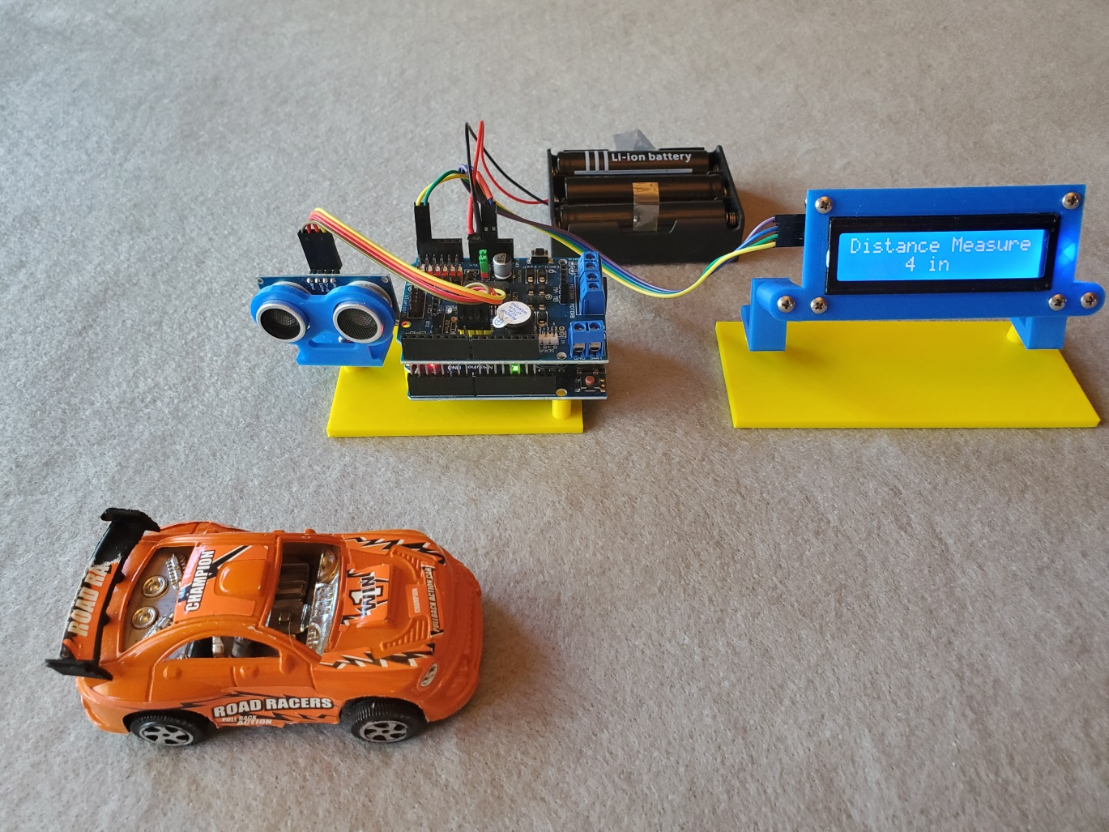
Measure Distance…
Arduino measuring distance with Ultrasonic sensor…

Slide 13
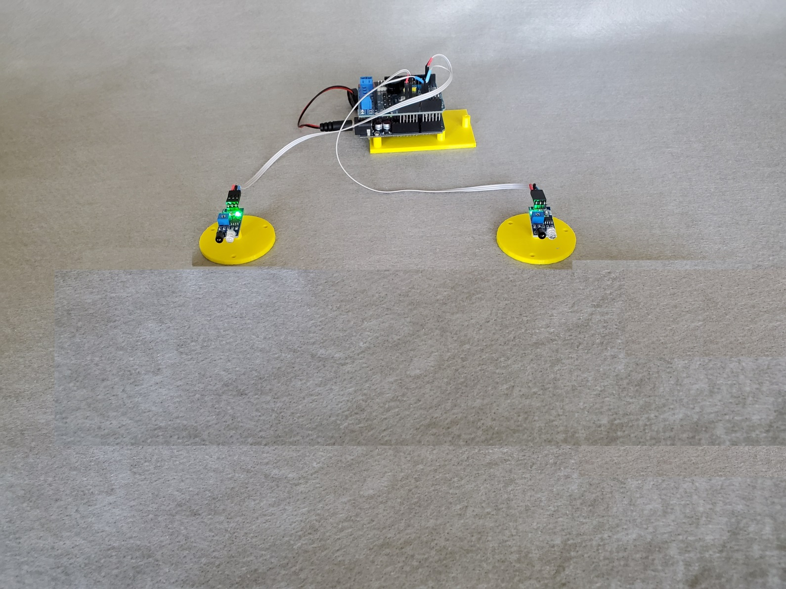

Measure Speed…
Sensor Start
Sensor End
12 inches
Distance
_______
Speed =
second
distance
speed =
time
Click

Slide 14
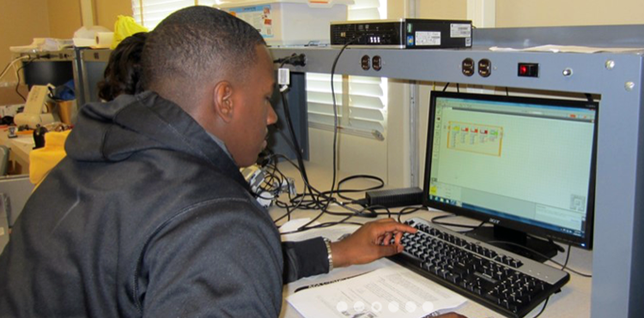
Career choices start early…
Positive experiences & teacher encouragement…
support good decisions!

Slide 15
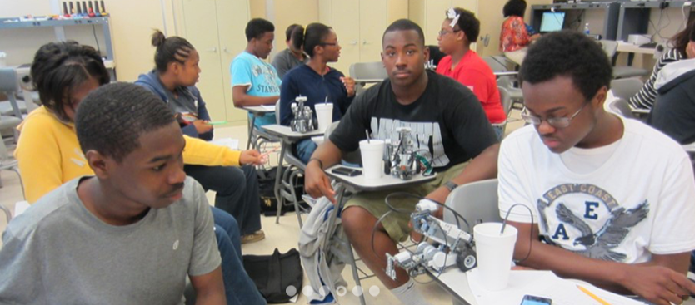
Building technical things…
Can lead to good career goals and choices!

Slide 16
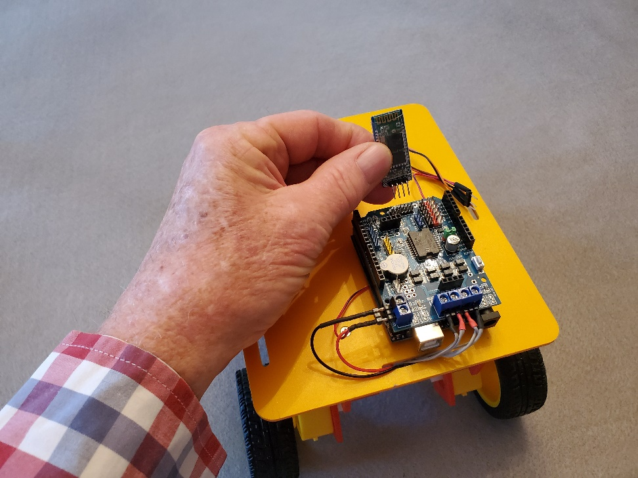
Rover Project
Bluetooth Radio
Bluetooth Rover – Smart phone app provides human control
An autonomous Rover – Rule-based decisions to find its way…

Slide 17
STEM Concepts
Collect, organize, and interpret data from the basic principles of motion through simulation or hands-on project…
Collect, organize, and interpret data from the basic principles of energy through simulation or hands-on project to include:
    Electrical Energy
    Kinetic Energy (KE = 1/2mv² )
    Potential Energy (U=mgh)
    Work w = f X d
    Work-energy theorem (W= KE)
    Conservation of Energy
    Momentum (p = mv)
    Conservation of momentum
Mississippi Department of Education/CTE

Slide 18
Summary
Devices used to detect and respond to electrical, optical, or physical properties
Sense light, temperature, pressure or physical properties (chemical, biological)
Sensor examples – pacemaker - smart watch - cell phone - digital camera – glucose monitor - heart monitor - home security system…
Five senses - sight, hearing, smell, touch, and taste

Slide 19
Resources
Top Ten Sensors + Projects
Touch sensors - What they are...
Top Used Sensors for Arduino
Using Infrared Sensor With Arduino
31 Education Projects
Search for High School Arduino Sensor Projects

